Slide 1
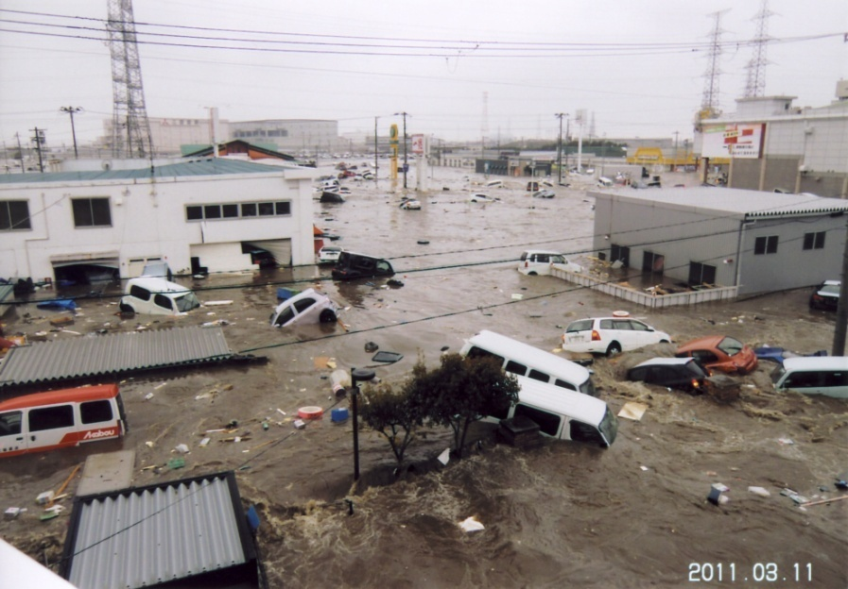
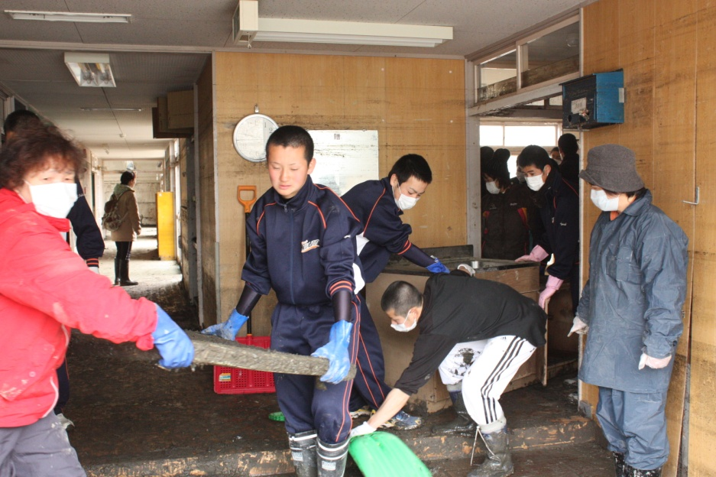
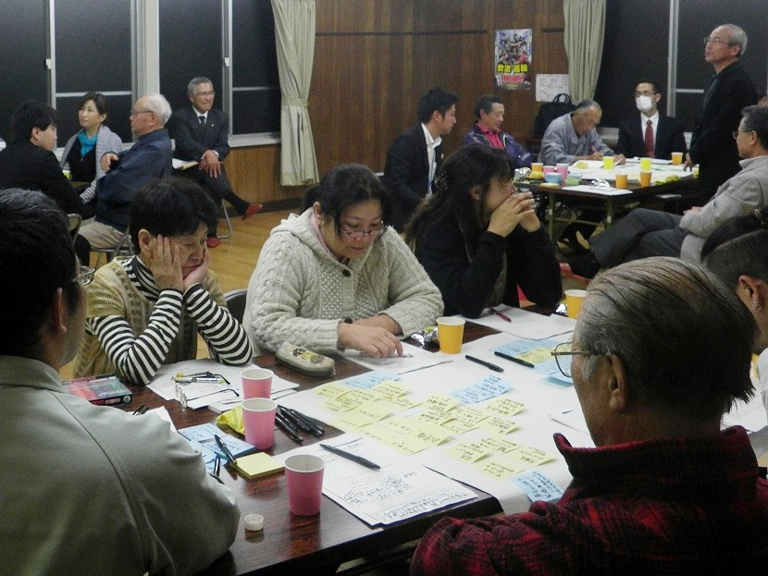
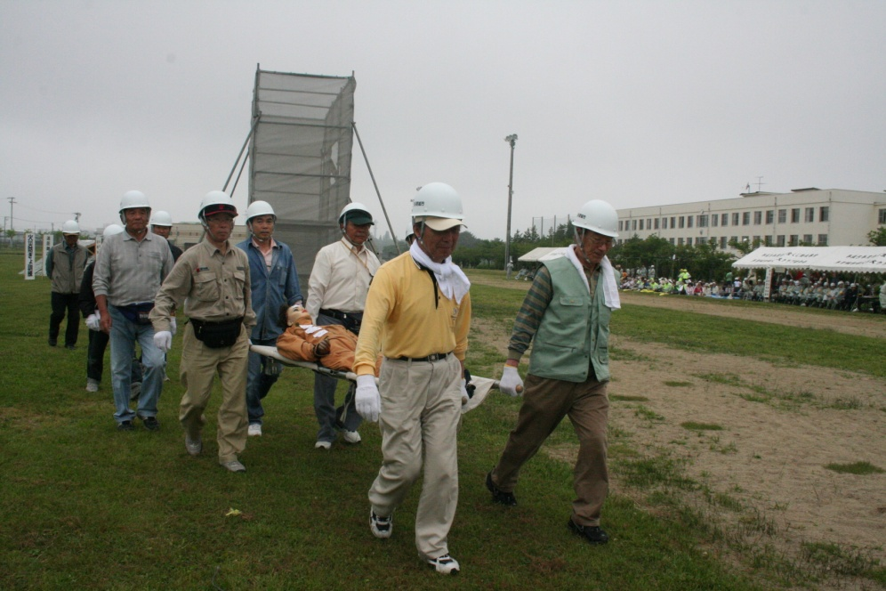
Towards disaster risk
reduction city-Tagajo
～Disaster-resilient city～
～ＡＰＲＵ－ＩＲＩＤｅＳ summer school～
Tagajo City, Miyagi
Wed. July 23, 2014

Slide 2
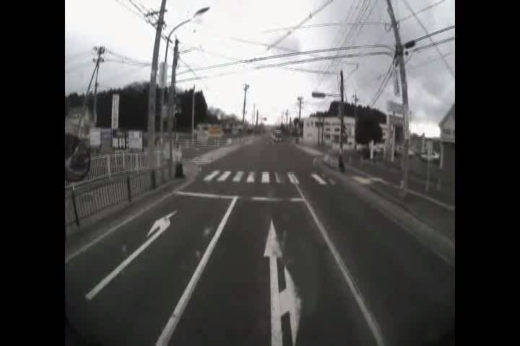

Slide 3

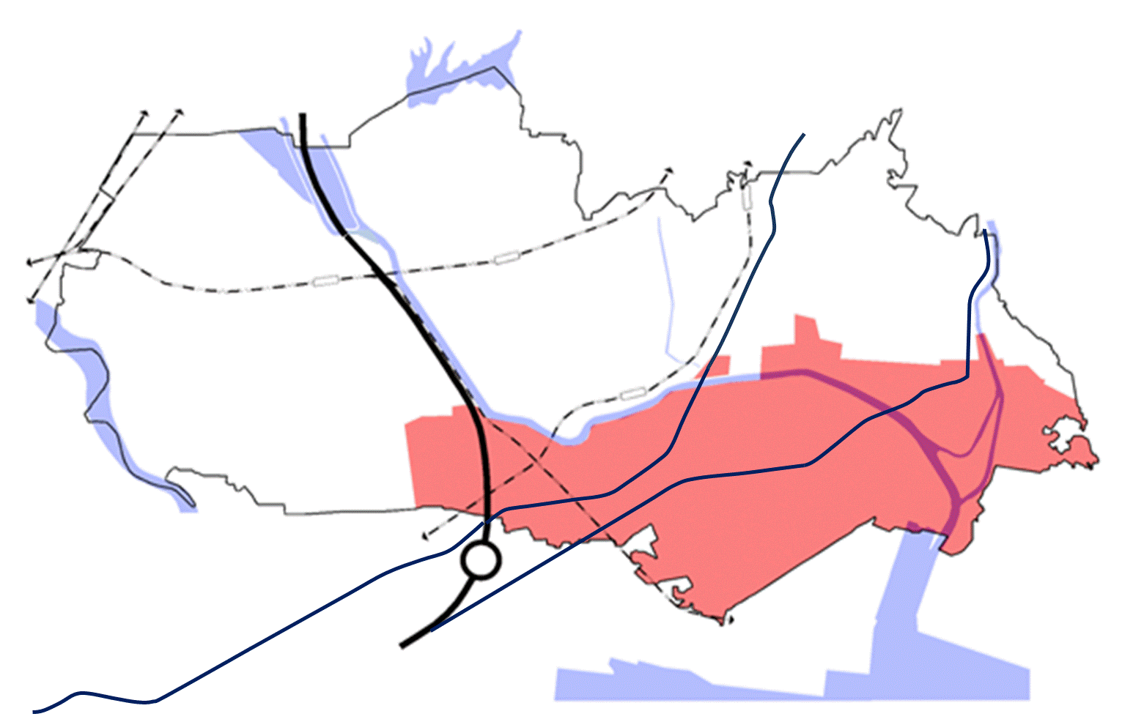
１. Damage by “the Great East
Japan Earthquake & Tsunami”
Tagajo, Miyagi
Miyagi Pref.
Tagajo City
Sendai City
･･flooded downtown area
･･flooded non-downtown area
Sendai Port
Takajo City
Damage
◆Location: 12km from
downtown Sendai
◆Population: 62,000
◆Area: 19.65 km²
◆Density: approx. 3,100/km²
top in Tohoku area
◆Traffic: 76,000cars／day
◆Max. seismic intensity: 5+
◆Flooded area: 662ha(1/3 of the city) → 90% downtown
◆Max. height of flood: 4.6m
◆Number of Deaths: 188 ( citizen 97, non-citizen 91）
◆Destroyed houses: over 11,000（including full, half , partial）
◆Approx. 1,400 family have escaped to temporary housing
◆Approx. 8,500 cars were floated into the city
◆Volume of rubble : 353 kiloton

Slide 4
Tagajo, Miyagi
２. Towards reconstruction
Outline of reconstruction plans in Tagajo City
◆Reconstruction measures
◆Priority issues
Housing & employment
Awareness raising of disaster risk reduction
Reconstructing citizen’s lives and industry
Reconstruction of industry and support to its opening
Sharing disaster experience
◆Current Status
Ｄｄ
Make use of history, landscape & culture
Strong will to reconstruction
Securing safety & security
Rapid restoration
Redevelopment of the train station area
Ｄｄ
Disaster risk reduction measures
Damages in downtown area
Sharing disaster experiences
& enhancing attractiveness of towns
Reconstruction
Small city
Development
3 years
Ｄｄ
Reborn
4years
Recovery
3years
Reconstruction on the spot!

Slide 5
３ ．History of natural disasters in Tagajo City
Tagajo, Miyagi
【Heavy rain】
【Earthquake & Tsunami 】
1986年
8.5 Heavy Rain
Date：Aug. 5, 1986
Cause：Typhoon No.10
Total rainfall：394mm
Max. rainfall：37mm/h
Flooded above floor：2,817 houses
Flooded below floor： 1,468 houses
869年
Jogan Earthquake（subduction-zone）
Year：869（Heian period）
Magnitude：8.3
1978年
Miyagiken-oki Earthquake (subduction)
Date：Jun. 12, 1978
Magnitude：7.4
Seismic intensity：5 (Sendai, Ishinomaki)
1994年
9.22 Heavy Rain
Date：Sep. 22, 1994
Cause：low pressure
Total rainfall：305mm
Max. rainfall ：119mm/h
Flooded above floor ：667houses
Flooded below floor： 903 houses
2003年
Miyagiken-oki Earthquake (subduction)
Date：May 26, 2003
Magnitude ：7.0
Seismic intensity ：4 (Tagajo )
2000年
Miyagiken-hokubu Earthquake (epicentral)
Date：Jul. 26, 2003
Magnitude ：6.2
Seismic intensity ：4 (Tagajo )
2002年
7.11 Heavy Rain
Date：Jul. 11, 2002
Cause：Typhoon No.6
Total rainfall：171mm
Max. rainfall：43mm/h
2005年
Miyagiken Earthquake (subduction)
Date：Aug. 16, 2005
Magnitude ：7.2
Seismic intensity ：4 (Tagajo )
9.21 Heavy Rain
Date：Sep.22, 2011
Cause：Typhoon No.15
Total rainfall：310mm
Max. rainfall：49mm/h
Flooded above floor：15houses
Flooded below floor：315houses
Iwate-Miyagi Nairiku Earthquake (epicentral)
Date：Jun. 14, 2008
Magnitude：7.2
Seismic intensity ：3 (Tagajo )
2011年
2008年
Great East Japan Earthquake (subduction)
Date：Mar. 11, 2011
Magnitude ：9.0
Seismic intensity：5+
2011年

Slide 6
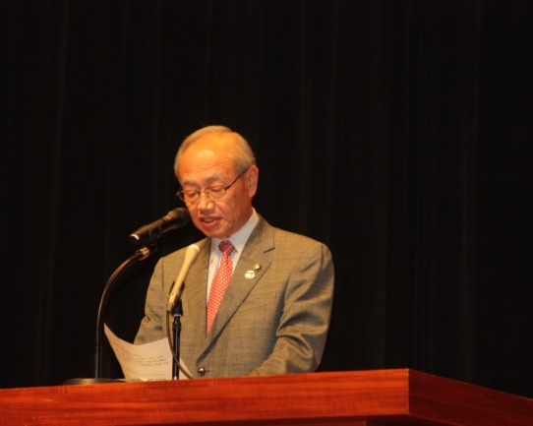
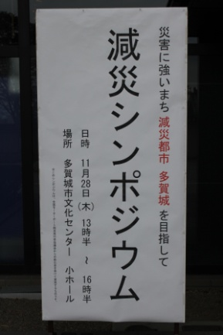
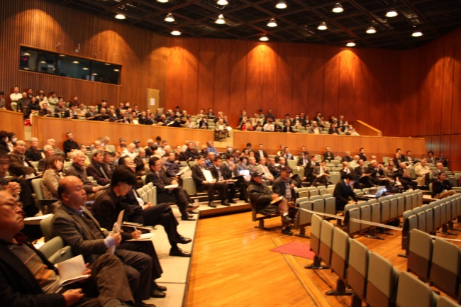
４ ．Towards disaster risk reduction city
Tagajo, Miyagi
Declaration of DRR City
Tagajo city, which has a long history and tradition, was suffered from many natural disasters such as Jogan Earthquake in ancient times and 8.5 / 9.22 Heavy Rains in recent years.
The Great East Japan Earthquake caused devastating damage to the northeast region of Japan, making us feel how powerless we are in the face of Nature.
We cannot rule out the possibility of suffering from terrible disasters again like flood, typhoon, landslide, earthquake, tsunami and so on.
Therefore, in order to prepare for future disasters, we have to pass on to the next generation our experience and lessons obtained by surviving natural disasters.
We need to understand that each of us is an agent of town/city development, and to learn from the history based on the roles of self-help, mutual assistance, and support by public bodies, and the mutual collaboration. From such point of view, we will promote “Disaster Risk Reduction” to minimize damage not only as responsible individuals but also as cooperative citizens.
We will also make efforts to protect human lives as top priority, to prepare for disasters, to minimize damage, and to recover rapidly. Aiming to realize such city, we hereby declare “DRR city – Tagajo.”
Nov. 28, 2013
Minimizing damage :
disaster risk reduction (DRR)！
Disaster risks :
earthquake
tsunami
heavy rain
Disaster damage and records
Experience/Lessons
from the Great East
Japan Earthquake and Tsunami
Tagajo DRR city strategy
Disaster-resilient City
「Disaster risk reduction city – Tagajo」

Slide 7
５ ．Tagajo DRR city strategy ①
Tagajo, Miyagi
Strategy for DRR city
Mechanism
Strategy for DRR city
Future plan
1
Building multiple barriers for tsunami
2
Developing earthquake-resilient city
Developing disaster-resilient city
3
Minimizing flood damage
enhance safety
4
Developing disaster response system
To save lives:
prepare for disaster
minimize damage
restore rapidly
Increasing DRR capacity based on self and mutual help
5
Enhancing self-help ability
improve
living environment
revitalize
local economy
6
Strengthening community DRR capacity
DRR city - Tagajo
Sharing disaster experience
7
Sharing disaster experience
invigorate city
DRR technology
8
DRR Research Park Program

Slide 8

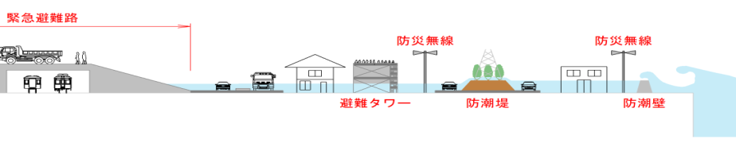


５ ． Tagajo DRR city strategy ②
Tagajo, Miyagi
1
Building Multiple barriers for tsunami
【Project】
・Multiple barriers
・Evacuation roads
・Escape towers
・Dissemination of evacuation
announcement
Facilities & systems have been built as the foundation of local recovery
Aim
【multiple defenses image】
Emergency radio system
Evacuation road
Escape tower
Green barrier
Seawall
2
3
Minimizing flood damage
Development of earthquake-resilient city
Flood damage by heavy rain is reduced
Buildings have earthquake resistant structure
Aim
Aim
【Project】
・Rainwater draining system
・Rainwater draining pump
・Side ditches
【Project】
・Earthquake resistant roads and bridges
・Earthquake resistant wooden buildings
4
Development of disaster response system
【Project】
・Evacuation site management
manual
・Stockpile facility
・Distribution base for relief
supplies
Disaster response system including rescue, evacuation and recovery is established
Aim

Slide 9


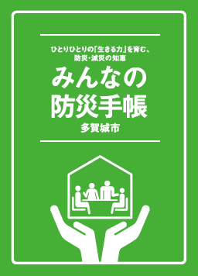
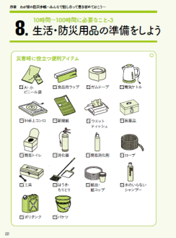
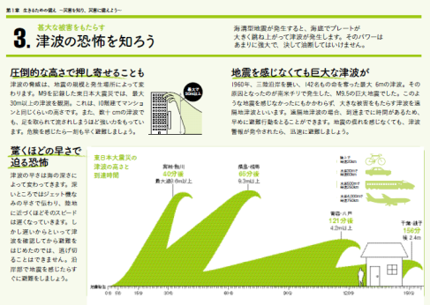
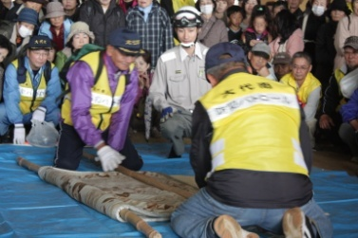
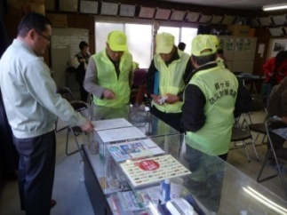
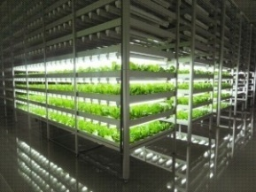
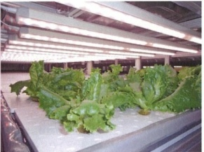
５ ． Tagajo DRR city strategy ③
Tagajo, Miyagi
5
6
Development of DRR & disaster prevention
Disaster preparedness capacity of each citizen is fulfilled
Local DRR capacity as assistance by pubic bodies is increased
Aim
Aim
【Handbook】
【emergency drill】
【Project】
・Local emergency drill
・Voluntary disaster
prevention organization
7
Sharing disaster experience
【Project】
・DRR education
・DRR handbook
・Tsunami hazard map
Disaster experience and records are disseminated
Aim
【Project】
・Sharing experience & lessons
【DRR education】
8
DRR Research Park Program
【lettuce grown in artificial light】
Tsunami damping
technology
Utilize
sustainable
energy
Various DRR technology and products are developed
Aim
Robot
technology
Tagajo
Alternative
food supply
system
【Project】
・Promotion of DRR technology development
・Joint meeting of industry, academia and government
・Joint research with private sector and university
Network &
control system
Develop
emergency food
【image of DRR technology】

Slide 10
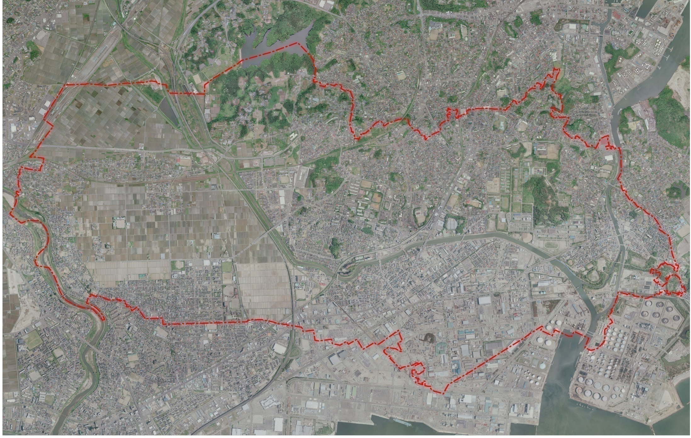
６ ．Efforts based on DRR strategy①
Tagajo, Miyagi
Developing disaster-resilient city
1
Sunaoshi river
City Hall
Base housing complex
Escape tower
Evacuation road
Sendai Port
Sea bank and Seawall

Slide 11

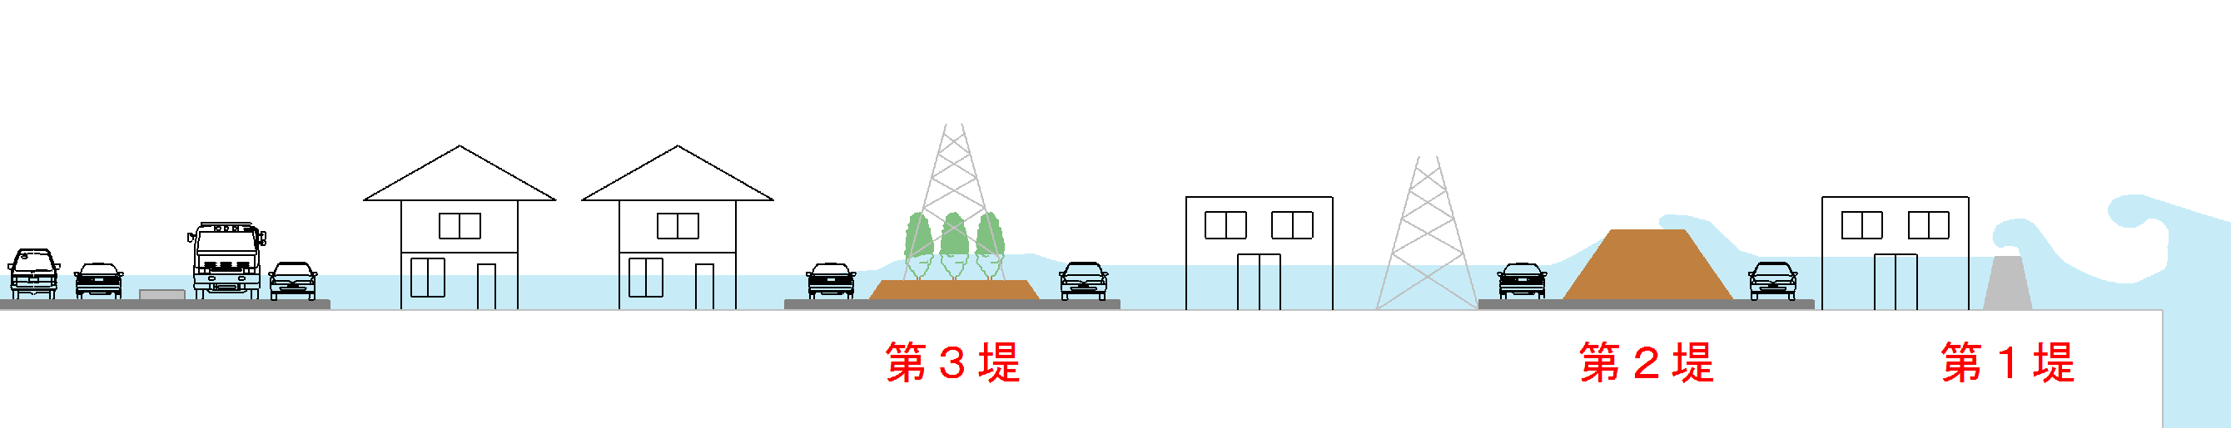
６ ． Efforts based on DRR strategy ②
Developing disaster-resilient city
1
～ Prevent Tsunami! Reduce tsunami impact! ～
Sendai Port
Green barrier
Sea bank
Seawall
Sunaoshi river
Green barrier
Sendai Port
Sea bank and Seawall

Slide 12
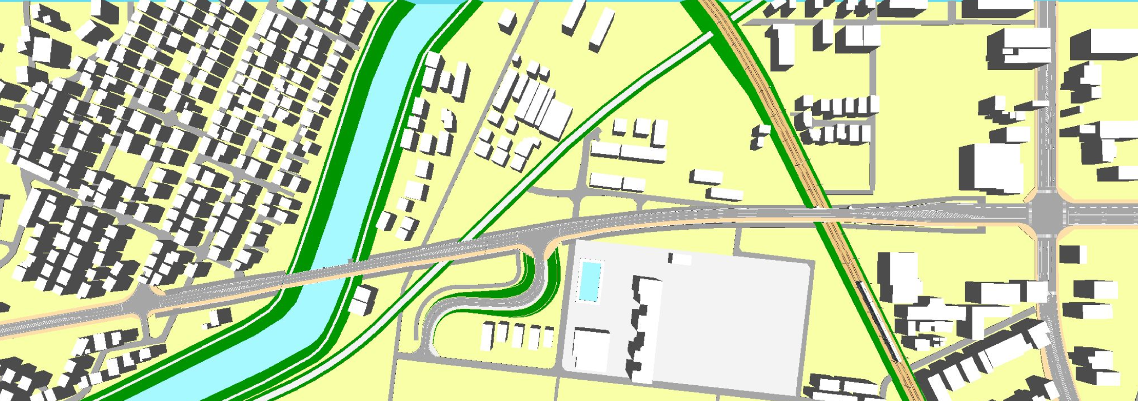
６ ．Efforts based on DRR strategy ③
Developing disaster-resilient city
1
～Escape from Tsunami！～
railway
national road
Sunaoshi river
river
railway
elementary
school
develop evacuation road
Sendai Port

Slide 13
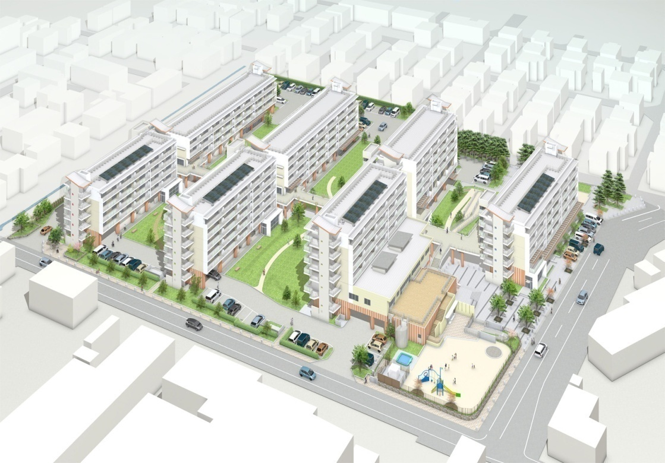
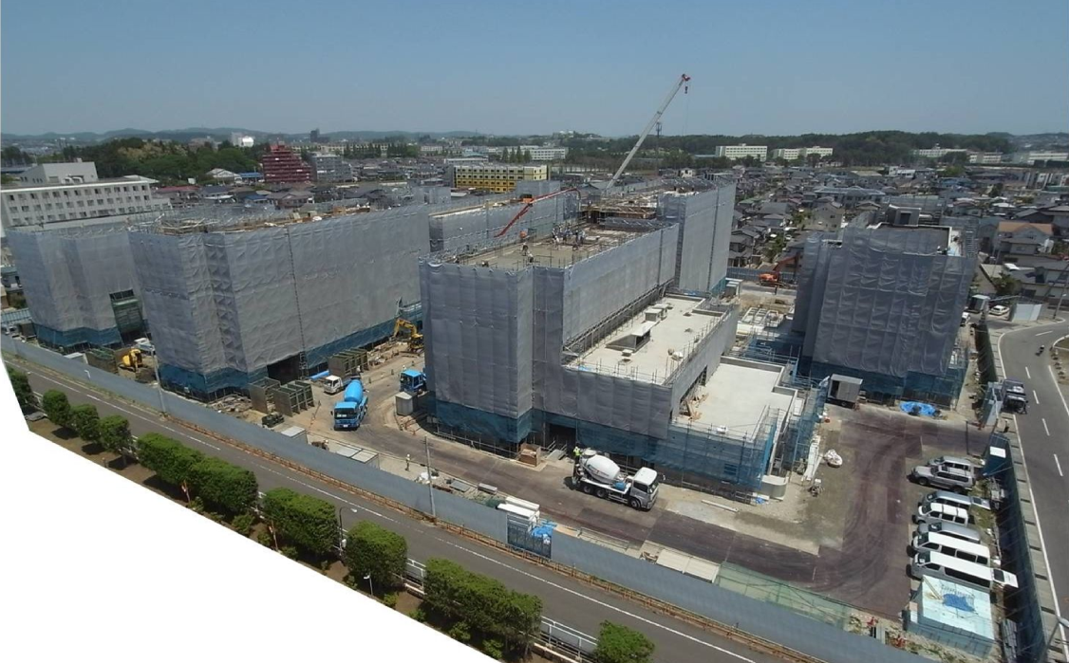
６ ．Efforts based on DRR strategy ④
Developing disaster-resilient city
1
～ Escape from Tsunami！ ～
桜木地区 災害公営住宅イメージ図
City Hall
escape tower
Disaster public housing
in Sakuragi area Jun.2
【Features of Sakuragi area】
Pilotis structure on the first floor
Evacuation site & stockpile facility on the
rooftop
Support facility for the elderly & child care
facility ( also used as meeting places )
Each second floor is connected by
passageways to make meeting space
Sendai Port

Slide 14
６ ．Efforts based on DRR strategy ⑤
Developing disaster-resilient city
4
～Prepare for large tsunami！～
Sunaoshi river
City Hall
Base housing complex
Sendai Port

Slide 15
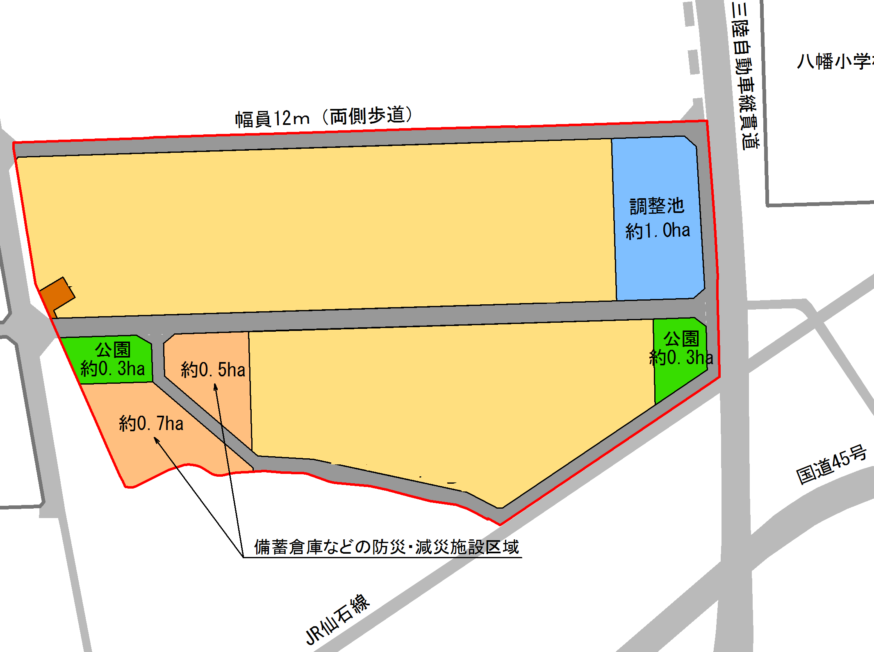
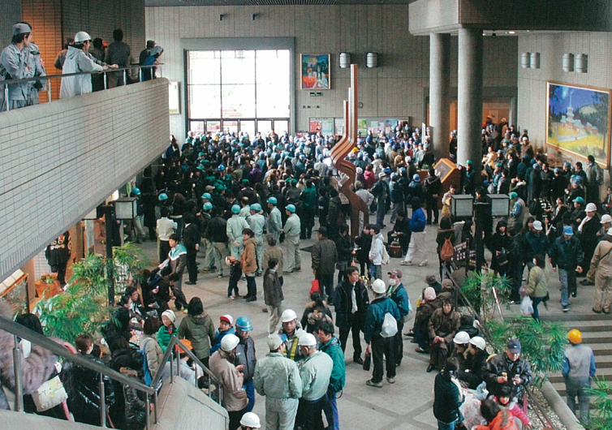


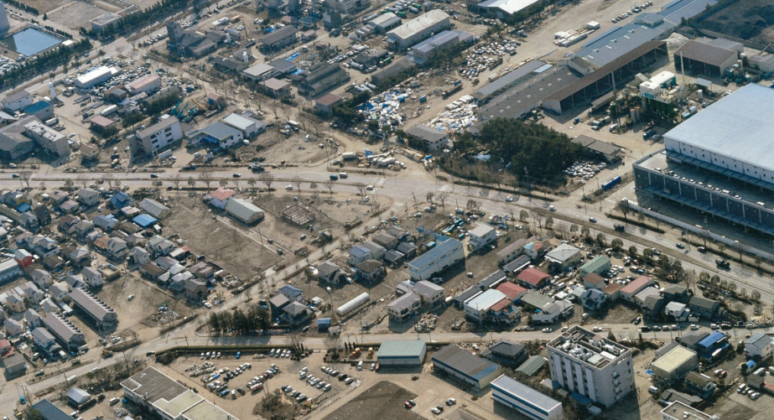
６ ．Efforts based on DRR strategy ⑥
Developing disaster-resilient city
4
～Prepare for large tsunami！～
Develop housing complex as
DRR base
industrial rehabilitation base
【DRR base function】
Accept people unable to go home
Food distribution etc.
Evacuation site
Road width:12m
DRR base function
Industrial area
park
Industrial area
Industrial area
Industrial
rehabilitation
base
Tsunami
flood
damage
Stockpile/Fire-fighting
base
【Industrial rehabilitation support function】
Manufacture on assignment, Production line lending etc.
Technical proposal, Development of markets etc.

Slide 16
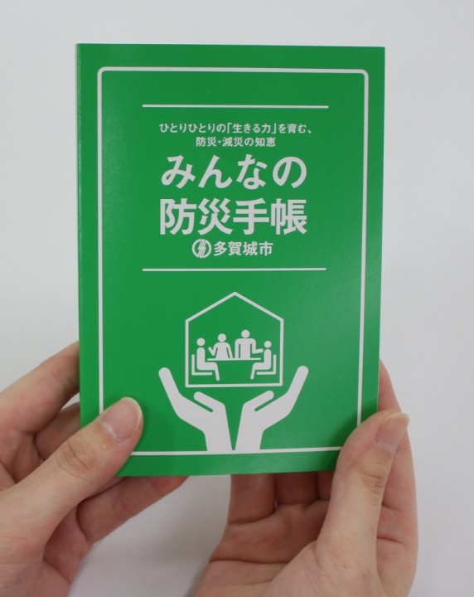
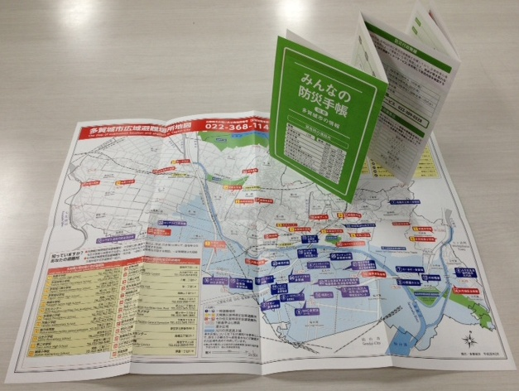
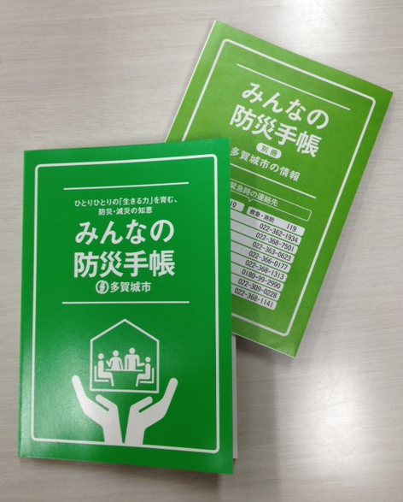
６ ．Efforts based on DRR strategy ⑦
Increasing DRR capacity based on self and mutual help
5
6
Strengthening community DRR capacity
～DRR Handbook : to prepare for disasters individually！～

Slide 17
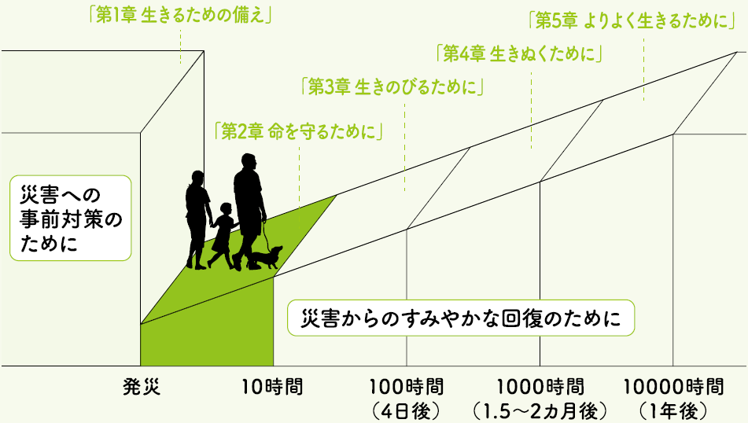
６ ．Efforts based on DRR strategy ⑧
Increasing DRR capacity based on self and mutual help
5
6
Strengthening community DRR capacity
～DRR Handbook : to prepare for disasters individually！～
Ch.1 Preparation to live
Ch.5 To live better
Ch.4 To live through
Ch.3 To survive
Ch.2 To save lives
To prepare for disasters in advance
To recover from disasters rapidly
disaster occur
10 hours
100 hours
(4 days)
1000 hours
(1.5–2 months)
10000 hours
( 1 year )

Slide 18
６ ．Efforts based on DRR strategy ⑨
Increasing DRR capacity based on self and mutual help
5
6
Strengthening community DRR capacity
～DRR Handbook : to prepare for disasters individually！～
Learn natural disaster threats and disaster preparedness in advance
Chapter 1. Preparation to live DRR life manual for daily life
～Know disasters and prepare for disasters～
Chapter 2. To save lives from disaster occurrence to 10 hours
～Save lives from disasters～
Chapter 3. To survive from 10 hours to 100 hours
～Survive severe living condition after a disaster strikes～
Chapter 4. To Live through from 100 hours to 1000 hours
～Live through severe condition better～
Chapter 5. To live better from 1000 hours to 10,000 hours
～Livelihood rehabilitation～

Slide 19
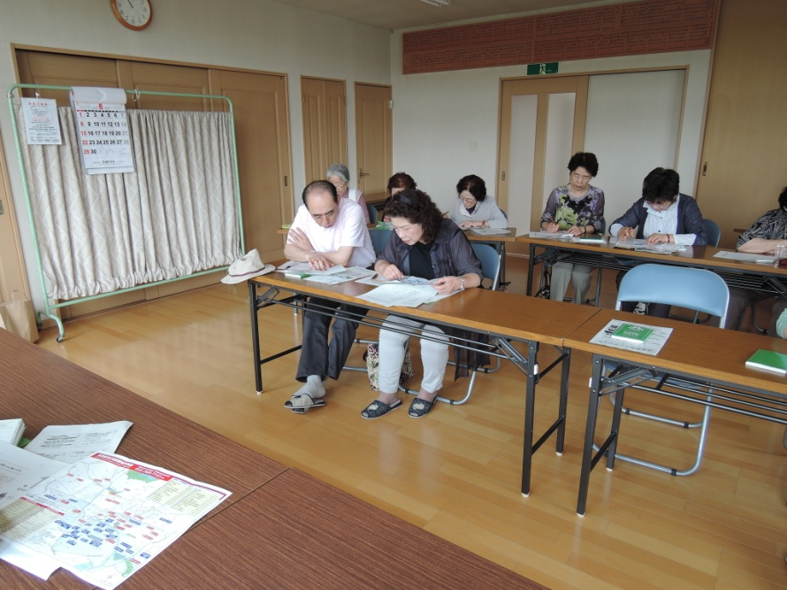
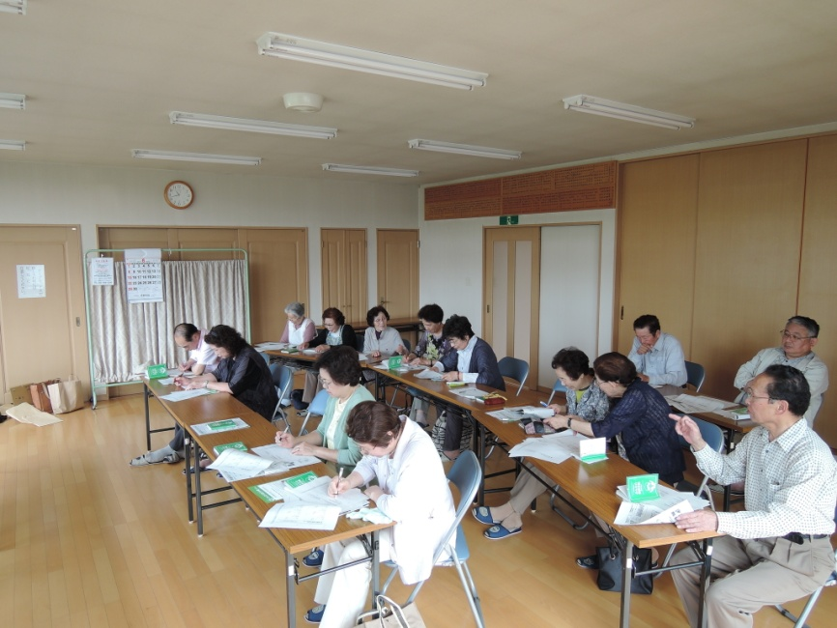
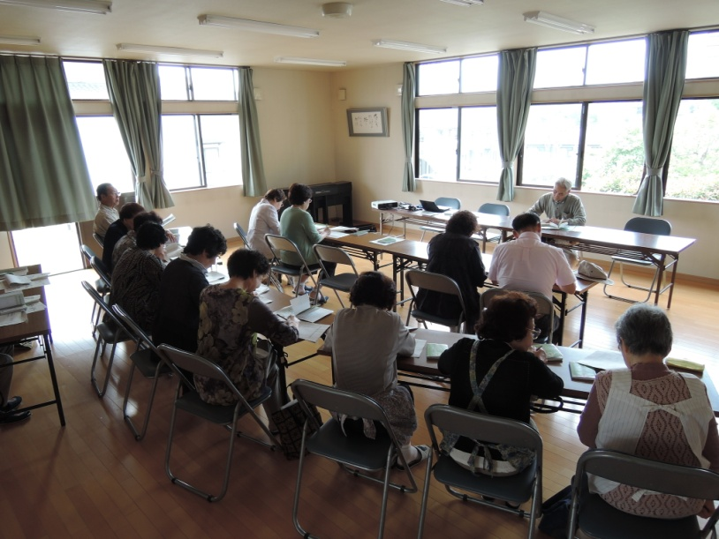
６ ．Efforts based on DRR strategy ⑩
Increasing DRR capacity based on self and mutual help
5
6
Strengthening community DRR capacity
～DRR Handbook : to prepare for disasters individually！～
Residents meeting with the Handbook

Slide 20

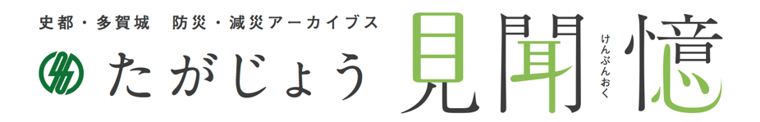
６ ．Efforts based on DRR strategy ⑪
Increasing DRR capacity based on self and mutual help
5
6
Strengthening community DRR capacity
Sharing disaster experience
7
Tagajo “ken-bun-oku”～ utilize, disseminate and pass on！～
Digital database: collect and reserve the records from the Tsunami and organize them systematically
It is disclosed on the internet.
Aiming to passing on records, experience and knowledge “to the next generation” without being forgotten.

Slide 21


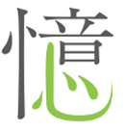
６ ．Efforts based on DRR strategy ⑫
Increasing DRR capacity based on self and mutual help
5
6
Strengthening community DRR capacity
Sharing disaster experience
7
Tagajo “ken-bun-oku”～ utilize, disseminate and pass on！～
Ken : What you saw and wrote down
digital image, video, document
Bun : What you heard and want to talk
experience story, opinion, knowledge
Oku : what you want to share and value
pass lessons on to the next generation
Disaster risk reduction city – Tagajo
21

Slide 22
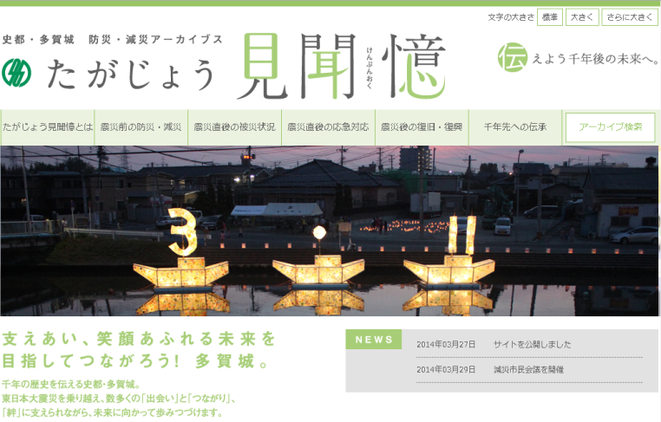
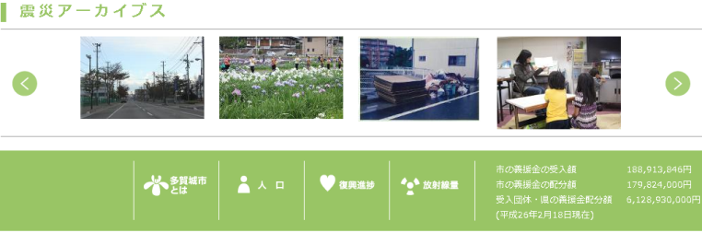
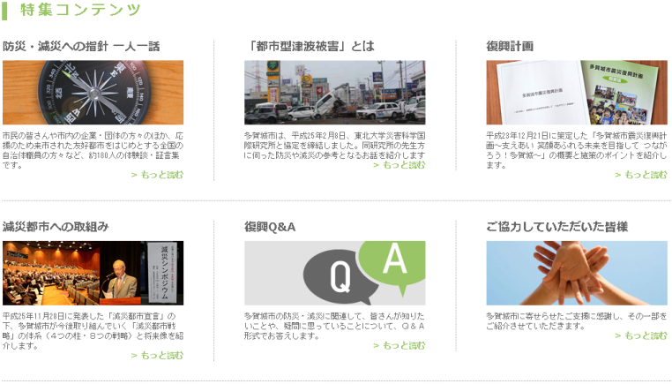
６ ．Efforts based on DRR strategy ⑬
Increasing DRR capacity based on self and mutual help
5
6
Strengthening community DRR capacity
Sharing disaster experience
7
Tagajo “ken-bun-oku”～ utilize, disseminate and pass on！～
【Contents】
Damage overview & emergency response
Recovery and reconstruction
from the disaster
One story per person
Damage caused by urban-type
tsunami
Reconstruction plan & project
Efforts towards DRR city etc.
【Features】
Video & photos over 20,000
Experience stories, opinions
& messages over 180
Keywords, time information retrieval system
～ DRR measures ～ Comprehensive site with lots of guidance, hints, and ideas for DRR.
22
22
22

Slide 23
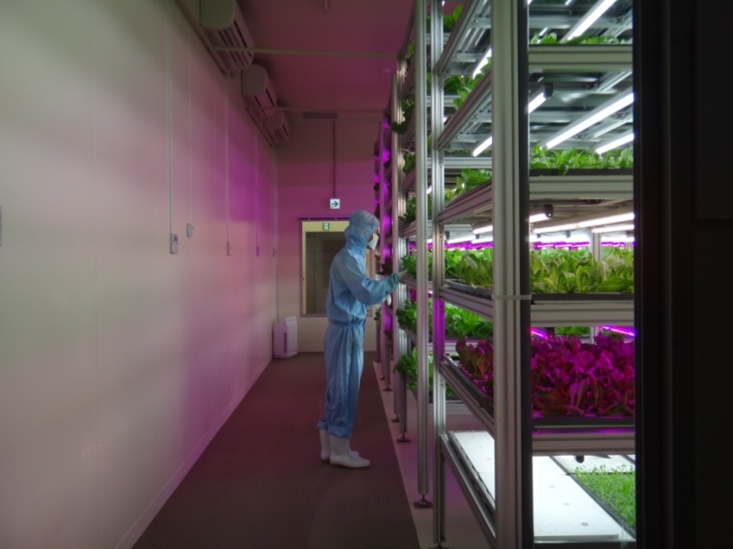
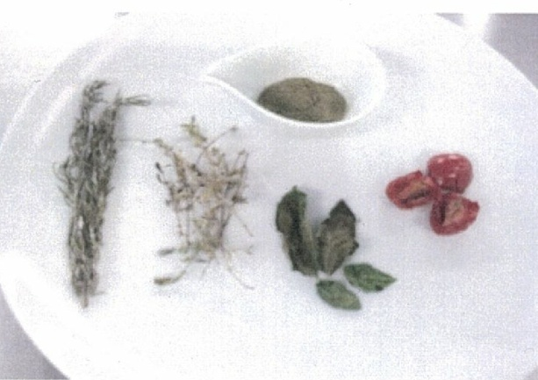
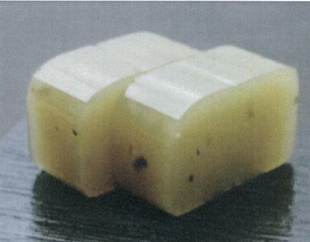

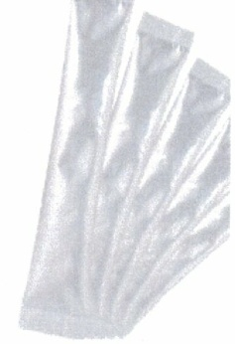
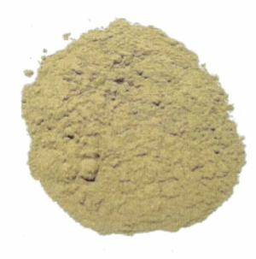
６ ．Efforts based on DRR strategy ⑭
DRR technology
8
DRR Research Park Program
～ New technology introduced after the Tsunami disaster ～
People worried about limited power supply and radioactivity…
→ necessity for safe & energy efficient foods
Most distributed foods were those with lots of carbohydrates…
→ concern about nutritional imbalance of children, pregnant women, etc
Lettuce grown in artificial light
sweet jelly
with vegetable powder
DRR measures
○ Develop food production technology unaffected by external environment
○ Establish stable food supply system under emergency
DRR measures
○ Develop & produce emergency foods with high nutrition value & stockpiles for emergency

Slide 24
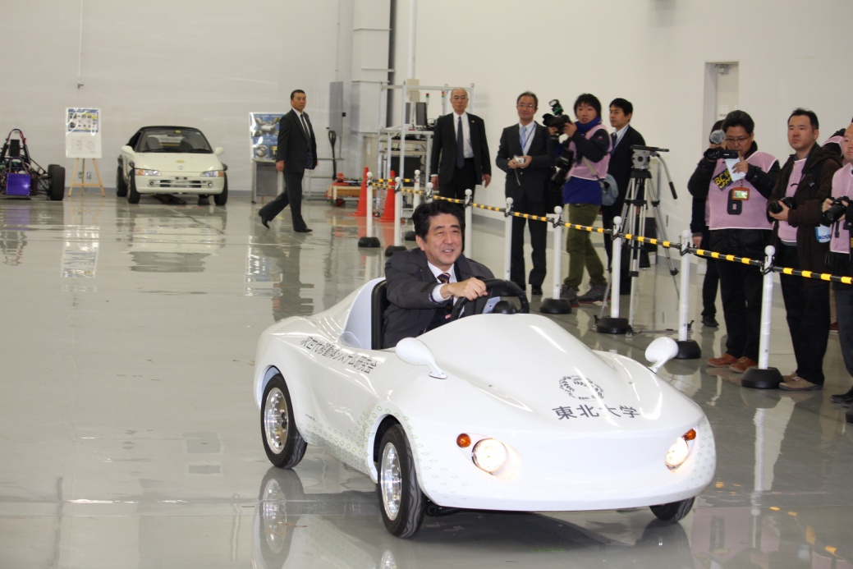
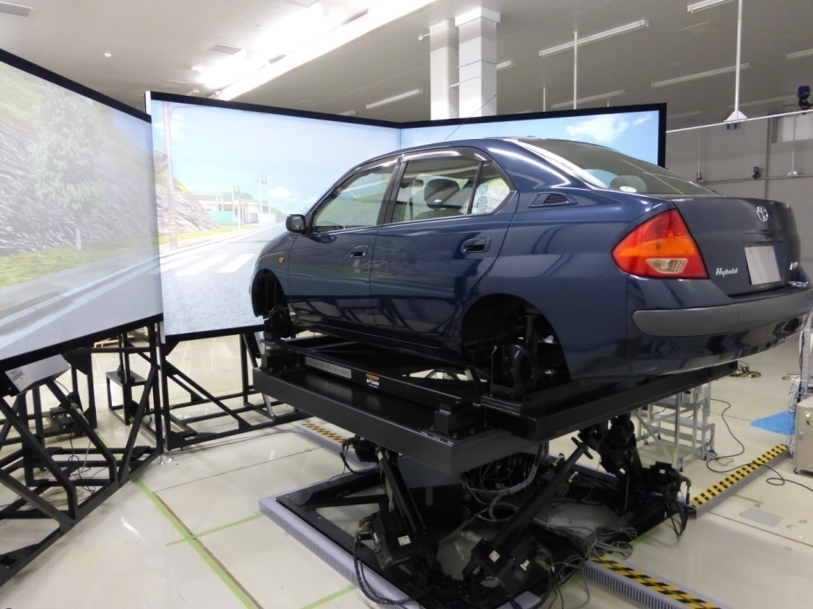
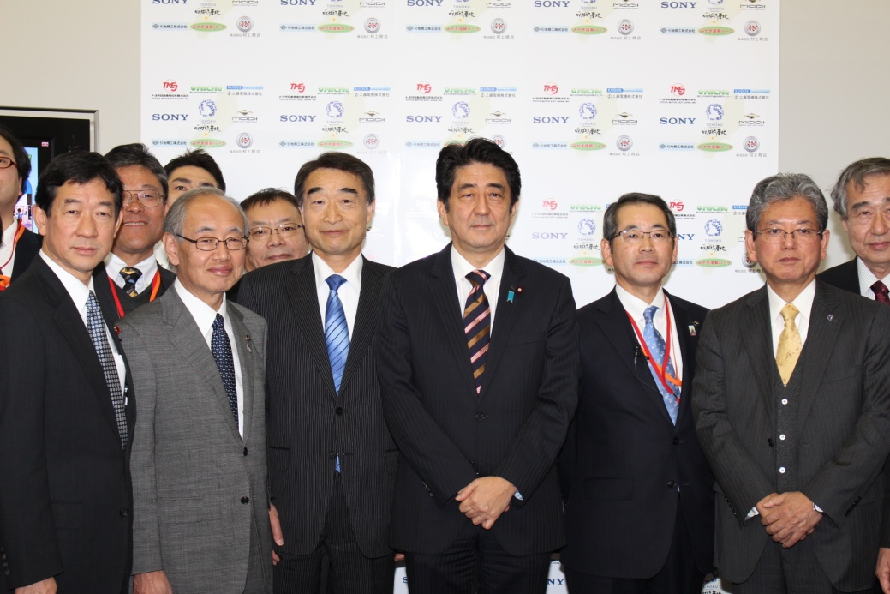
６ ．Efforts based on DRR strategy ⑮
DRR technology
8
DRR Research Park Program
～ New technology introduced after the Tsunami disaster ～
There were heavy traffic jams at the disaster…
→ necessity for guiding systems of evacuation routes
Research on next generation mobile body system
DRR measures
○ Develop systems to guide evacuating vehicles effectively
○ Reduce damage in urban areas with heavy traffic

Slide 25
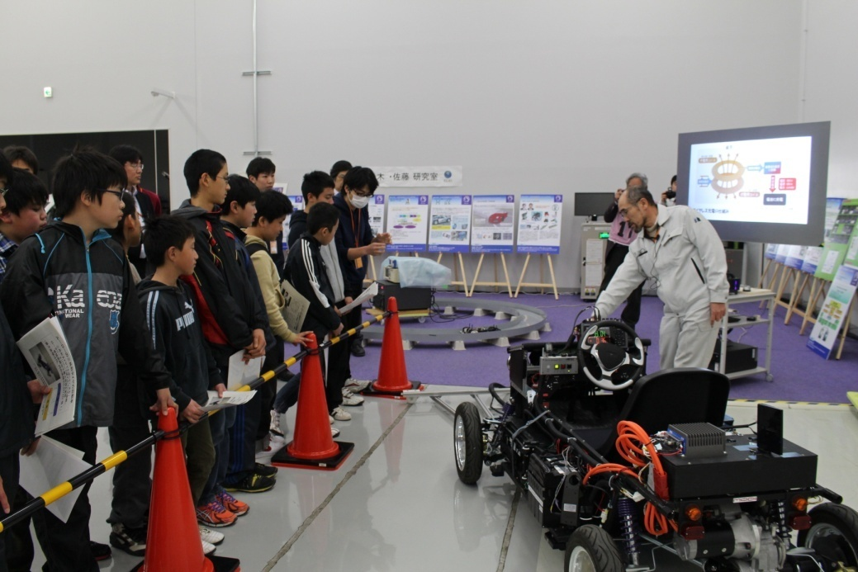
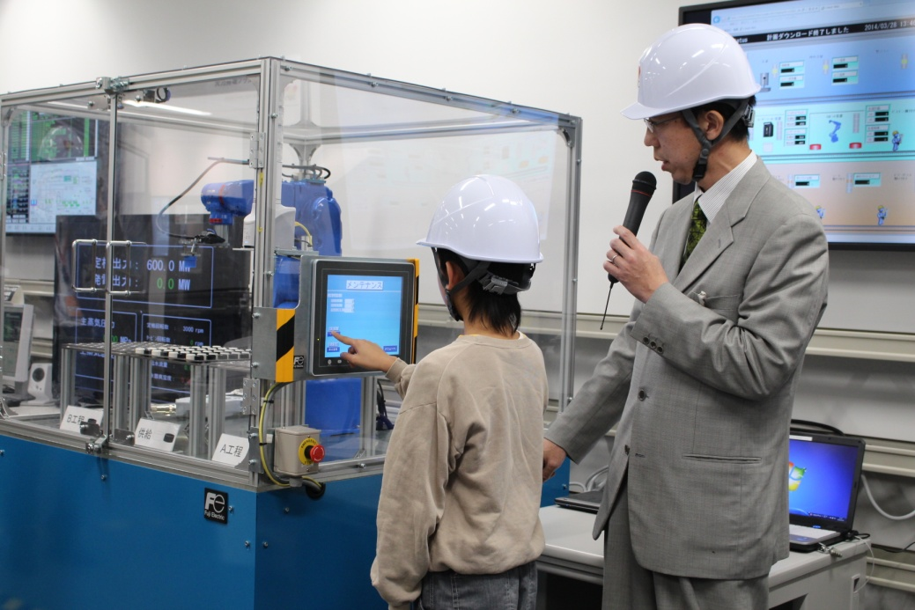
６ ．Efforts based on DRR strategy ⑯
Increasing DRR capacity based on self and mutual help
5
DRR technology
8
DRR Research Park Program
～ New technology introduced after the Tsunami disaster develops future DRR capacity ～
DRR measures
○ Raise children’ & parents’ awareness on DRR
○ Expand children' possibilities towards DRR

Slide 26
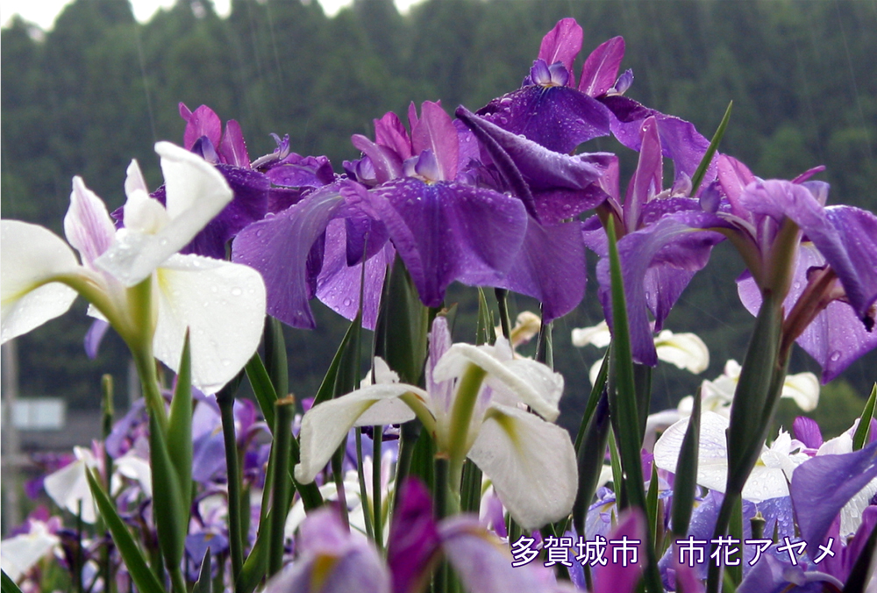
Thank you for your attention
We are steadily moving forward thanks to your support and cooperation
We will be built back better as「DRR City-Tagajo」!
We appreciate your continuous support

