Slide 1
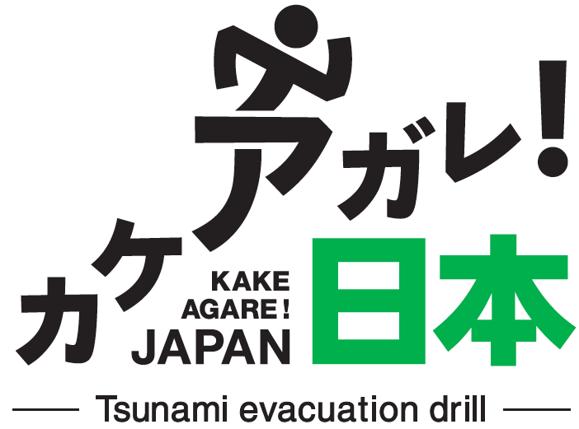
Project Outline
“KAKEAGARE! Japan” Planning Council
Tohoku University International Research Institute for Disaster Science (IRIDeS), Kahoku Shimpo Publishing Co., Dentsu Inc., Dentsu East Japan Inc.
【Official website】 http://kakeagare.jp

Slide 2

カケアガレ！（KAKEAGARE!）
means
run up! to a higher ground
1

Slide 3
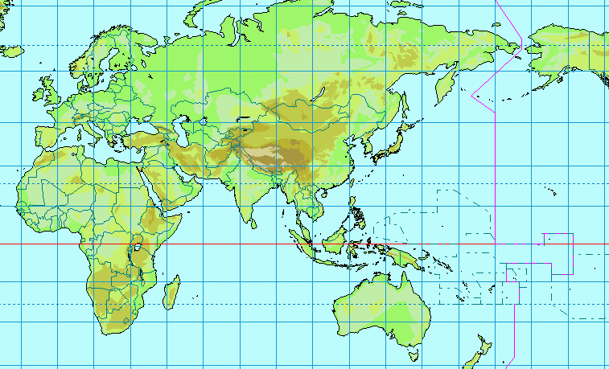
JAPAN

Slide 4
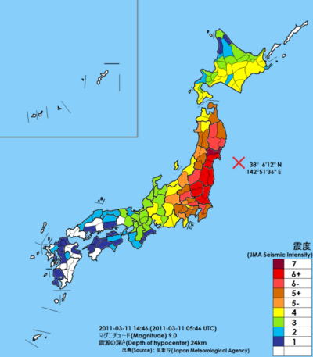
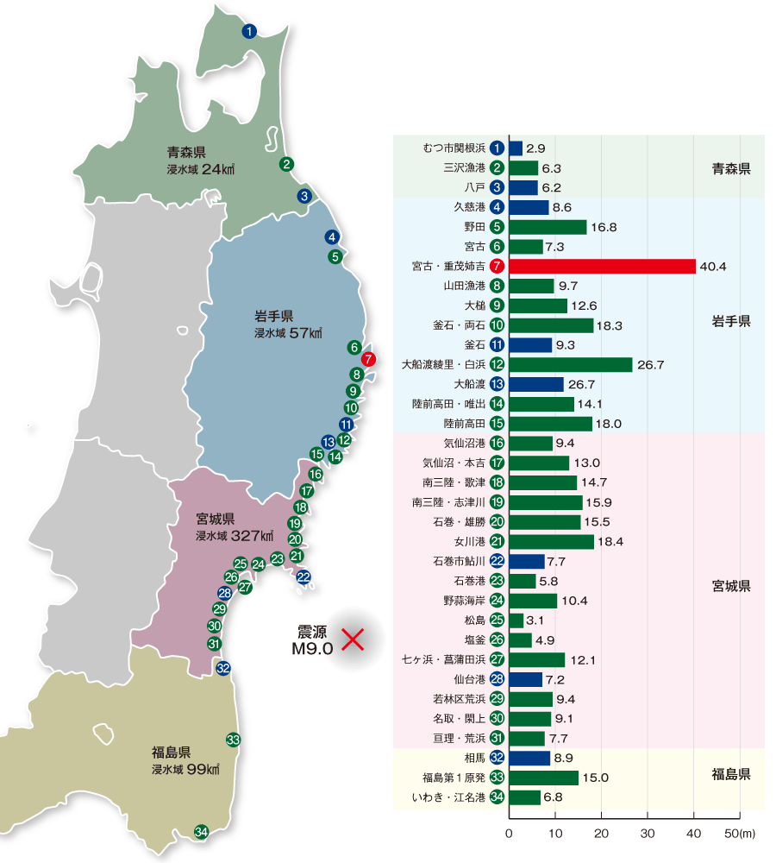
＜TOHOKU＞
※ tsunami height
IWATE Pref.
MIYAGI Pref.
FUKUSHIMA Pref.

Slide 5
What is KAKEAGARE!
This project was launched in September 2012 in the aftermath of the Great East Japan Earthquake and tsunami that caused a tremendous loss of life and property.
The aim of this project is to use the experience and lessons learned from this major disaster to develop a program of tsunami evacuation drills and create “a culture of evacuation” that habitualizes the practice of evacuation.
PR movie on YouTube ; https://www.youtube.com/watch?v=WBQCXxBgx1c
4

Slide 6
What KAKEAGARE! does
1. Resolution of the issues faced by areas regarding tsunami evacuation (creating evacuation rules unique to each area)
2. Development of an ongoing tsunami evacuation drill program to be carried out on a regular basis
3. Promotion and spread of the practice of tsunami evacuation drill programs for locations around Japan and around the world where major tsunamis are projected
We want to establish “Tohoku-originated tsunami disaster prevention actions” through the realization of these aims.
5

Slide 7
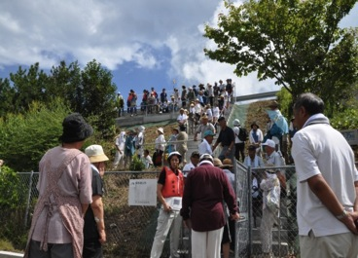
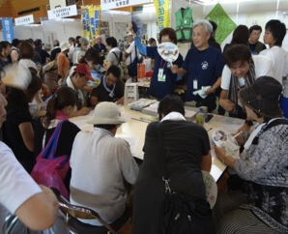
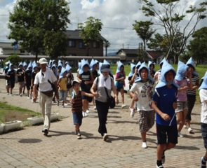
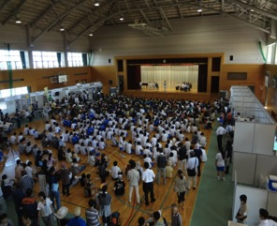
What KAKEAGARE! offers
“Variable Drill Programs” for Tsunami Evacuation
(The Development of Drill Programs Suited to Local Characteristics)
6

Slide 8
What KAKEAGARE! offers
Variable drill programs are being proposed that local residents can freely select and combine to meet the evacuation issues they face due to the characteristics of their area, such as terrain, population, and location of residential districts.
We aim to foster culture of evacuation.
7

Slide 9
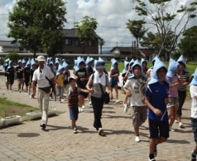




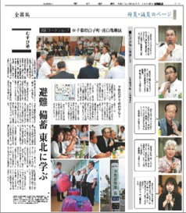

Process Leading to the Creation of a Tsunami Evacuation Drill Program
＜Tsunami evacuation drills＞
【Leaflets】
＜Workshops＞
Drill program based on local conditions (assessment criteria, points, etc.)
Expansion of program to other parts of Japan and the world (application of results to other areas)
【DVDs】
＜Collection and observation of cases＞
【Website】
8

Slide 10
Implementation System
Local governments and communities
Governments, neighborhood community associations, local autonomous disaster prevention organizations, fire brigades, women’s fire prevention clubs, NPOs and civic groups, boards of education, elementary and junior high schools, police, fire departments, etc.
Coordination/Support
“Kakeagare! Japan” Planning Council
Kahoku Shimpo Publishing Co., Local Newspaper Companies
Local area interaction using newspaper publishing networks, liaison with local governing bodies, civic groups, etc., and coordinator for local companies, NPOs, civic groups, etc.
Coordination
Tohoku University IRIDeS
(International Research Institute for Disaster Science)
Provides drill supervision, verification, surveys, advice for plan drafting, etc. based on scientific knowledge.
Dentsu Group
Matching, coordination of companies, NPOs, etc., citizen-participatory content development, advertising, PR materials, etc., utilizing the network of the Dentsu Group.
9

Slide 11
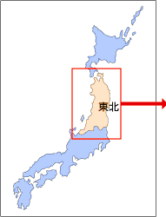
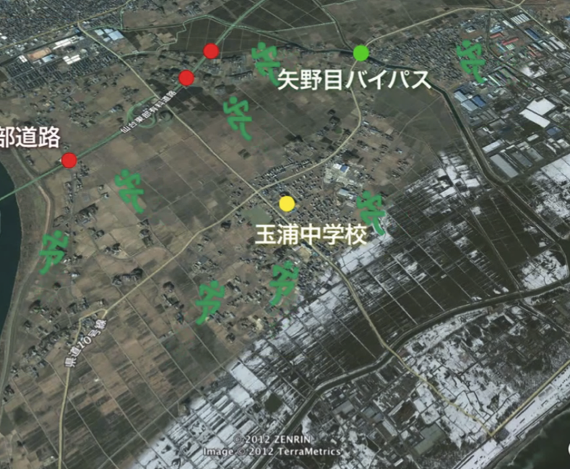
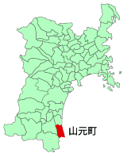
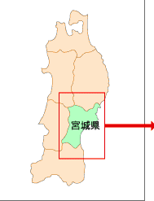
Case 01 | Iwanuma, Miyagi Prefecture(September 1,2012)
• Located on the Sendai plain, where there is no high ground and no tall buildings exist.
• The only elevated ground is a highway, the Sendai-Tobu Road. This was chosen as the evacuation site, and a drill was carried out to escape up to the roadway using stairs built after the earthquake.
Evacuation site
TOHOKU
Evacuation site
Evacuation site
IWANUMA
MIYAGI Pref.

Slide 12
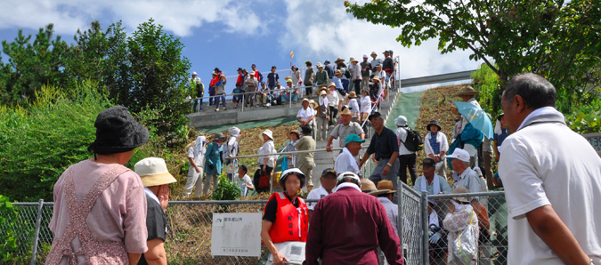
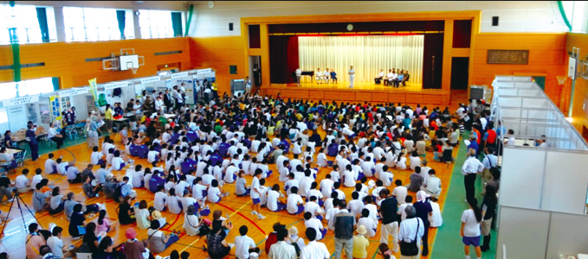
Case 01 | Iwanuma, Miyagi Prefecture(September 1,2012)
• After the drill was over, a disaster prevention event was held at a junior high school gymnasium, and the Self-Defense Forces cooked rice for the public.
• The area rule to “run up to the highway” gained widespread attention and was reported by newspapers and TV news programs nationwide.
○ No. of participants: 1,450
(approx. 30% of target residents)
Report on YouTube ; https://www.youtube.com/watch?v=oKJKj9moewk

Slide 13
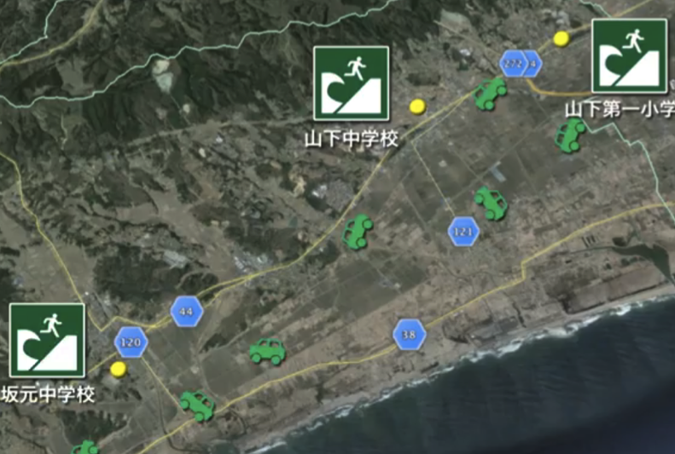
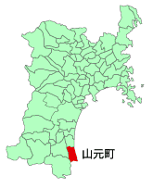
Case 02 | Yamamoto, Miyagi Prefecture(August 31,2013)
• The area is located on the Sendai plain, where there is no high ground and no tall buildings exist, requiring evacuation over a distance of several kilometers.
• A drill based on evacuation by car was carried out. (Those involved in recovery and reconstruction work also participated.)
TOHOKU
Evacuation site
Evacuation site
YAMAMOTO
Evacuation site
MIYAGI Pref.

Slide 14
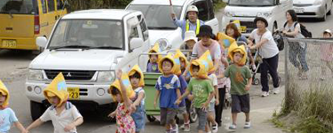
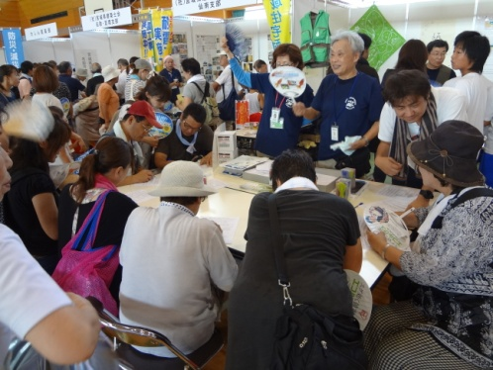
Case 02 | Yamamoto, Miyagi Prefecture(August 31,2013)
• After the drill was over, a disaster prevention event was held at a junior high school gymnasium, and a civic group exhibited a disaster prevention booth.
• The local “car evacuation” rule gained widespread attention and was reported in newspapers and on TV nationwide.
○ No. of participants: approx. 3,000 (600 cars)
Report on YouTube ; https://www.youtube.com/watch?v=dsfM8JoDXZ4

Slide 15
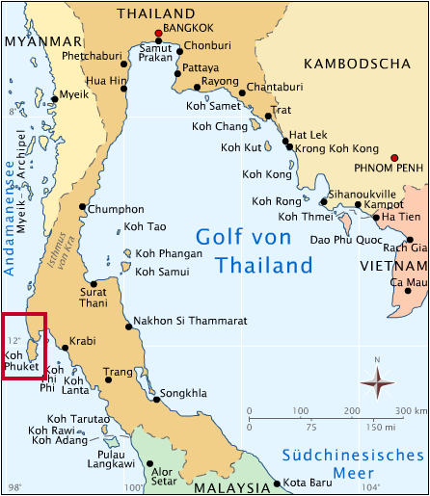
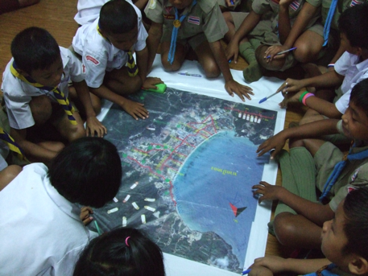
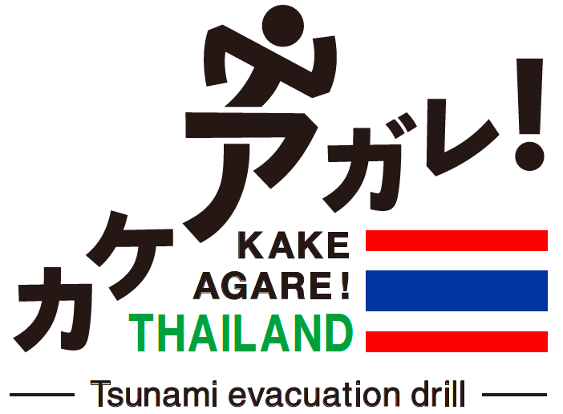
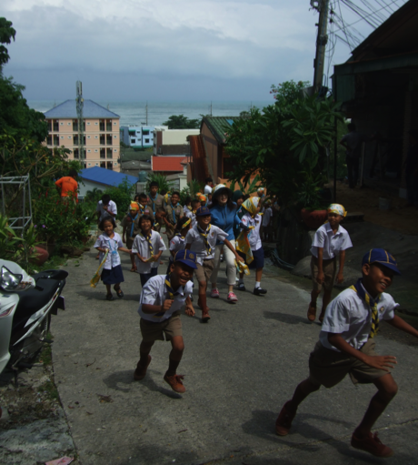
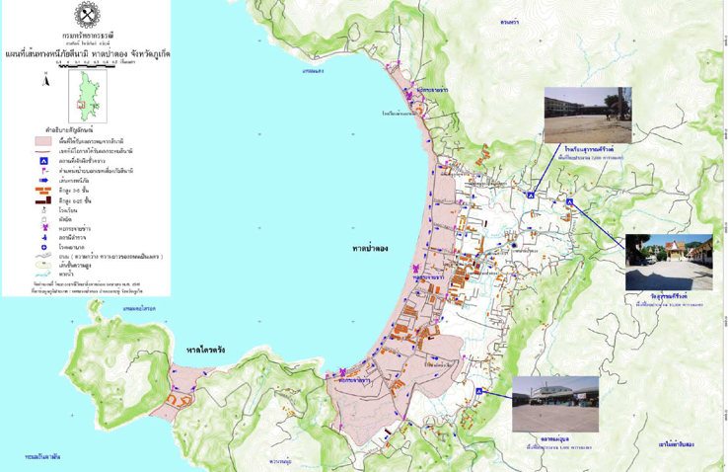
KAKEAGARE! THAILAND(June 18,2014)
Ban Kalim School
(Phuket, Thailand)
Incorporation with: Southern Meteorological Department (West Coast),TMD

Slide 16
Latest Evacuation Drills
In Japan (Disaster area)
Reconstruction Agency’s “New Tohoku” model project (since 2013)
Tsunami evacuation drills, etc., carried out in disaster-hit districts and areas in Miyagi, Iwate and Fukushima prefectures.
Tsunami evacuation drill in Kushiro, Hokkaido (June 23)
In conjunction with Kahoku Shimpo’s traveling workshop “Musubi Juku” a tsunami evacuation drill was held in the city of Kushiro, a joint project by Kahoku Shimpo and Hokkaido Shimbun.
Tsunami evacuation drill in Hamanaka, Hokkaido/ Miyazaki prefecture/ etc.
Tsunami evacuation drill in Phuket, Thailand (June 18)
Ten years after the 2004 Indian Ocean earthquake, disaster prevention classes and a tsunami evacuation drill were held in Phuket,Thailand.
In Japan (Non-disaster area)
Overseas

Slide 17
Training Topics in Tsunami Evacuation
“KAKEAGARE! JAPAN” provides various drill programs,
that can be “selected and combined”
by local governments and communities
according to local characteristics.
• Training topics related to tsunami evacuation were determined based on interviews with people in the local governments of all affected coastal areas in Miyagi prefecture. They are also based on the Miyagi prefectural draft guidelines for tsunami measures, the Kahoku Shimpo’s traveling workshop “Musubi Juku,” etc.
• The development and evaluation of the drill program is to be carried out for each training topic through tsunami evacuation drills, workshops, etc.

Slide 18
Training Topics in Tsunami Evacuation
Topic A. By Evacuee/Method/Location/Time
1. Persons needing assistance to evacuate
2. Students/children (on way to/from school)
3. Tourists, foreigners, etc.
4. Persons with pets
5. Company/business site (BCP)
6. Isolated community (remote island, etc.)

Slide 19
Training Topics in Tsunami Evacuation
Topic A. By Evacuee/Method/Location/Time
7. By Car
8. By Other vehicle (wagon, cart, etc.)
9. Tsunami evacuation tower, etc.
10. High ground substitute (highway, etc.)
11. Nighttime drill, etc.
12. Evacuation with snow on ground, etc.

Slide 20
Training Topics in Tsunami Evacuation
Topic B. Methods to Encourage Participation: Events
13. Create festival—incorporate into regular area event
14. Create school event—strengthen ties between school and community
15. Create entertainment—Make into fun event or game

Slide 21
Training Topics in Tsunami Evacuation
Topic C. Methods to Encourage Participation: Community Training
16. Raise awareness of evacuation—hand down from generation to generation
17. Raise awareness of evacuation—traveling workshop
18. Adapting to the “unforeseen”—in-situ evacuation drill
19. Train people—community disaster prevention leaders
20. Train people—evacuees to take initiative

Slide 22
Training Topics in Tsunami Evacuation
Topic D. Information Transmission and Collection
21. Transmit information—training to reach out to people
22. Gather information—training through disaster prevention apps

Slide 23
Training Topics in Tsunami Evacuation
Topic E. Evacuation Site
23. Evacuation center—training to set up a center and receive evacuees
24. Check on safety—evacuee list (use of media)
25. Check on safety—Disaster message board, etc.

Slide 24
Training Topics in Tsunami Evacuation
Topic F. Checklist
26. for drill organizers
27. for drill participants

Slide 25
Training Topics in Tsunami Evacuation
Topic A. By Evacuee/Method/Location/Time
Topic B. Methods to Encourage Participation: Events
Topic D. Information Transmission and Collection
1. Persons needing assistance to evacuate
13. Create festival—incorporate into regular area event
21. Transmit information—training to reach out to people
2. Students/children (on way to/from school)
14. Create school event—strengthen ties between school and community
22. Gather information—training through disaster prevention apps
3. Tourists, foreigners, etc.
15. Create entertainment—Make into fun event or game
Topic E. Evacuation Site
4. Persons with pets
Topic C. Methods to Encourage Participation: Community Training
5. Company/business site (BCP)
23. Evacuation center—training to set up a center and receive evacuees
6. Isolated community (remote island, etc.)
16. Raise awareness of evacuation—hand down from generation to generation
24. Check on safety—evacuee list (use of media)
7. By Car
17. Raise awareness of evacuation—traveling workshop
25. Check on safety—Disaster massage board, etc.
8. By Other vehicle (wagon, cart, etc.)
18. Adapting to the “unforeseen”—in-situ evacuation drill
9. Tsunami evacuation tower, etc.
19. Train people—community disaster prevention leaders
Topic F. Checklist
10. High ground substitute (highway, etc.)
20. Train people—evacuees to take initiative
26. for drill organizers
11. Nighttime drill, etc.
27. for drill participants
12. Evacuation with snow on ground, etc.

Slide 26
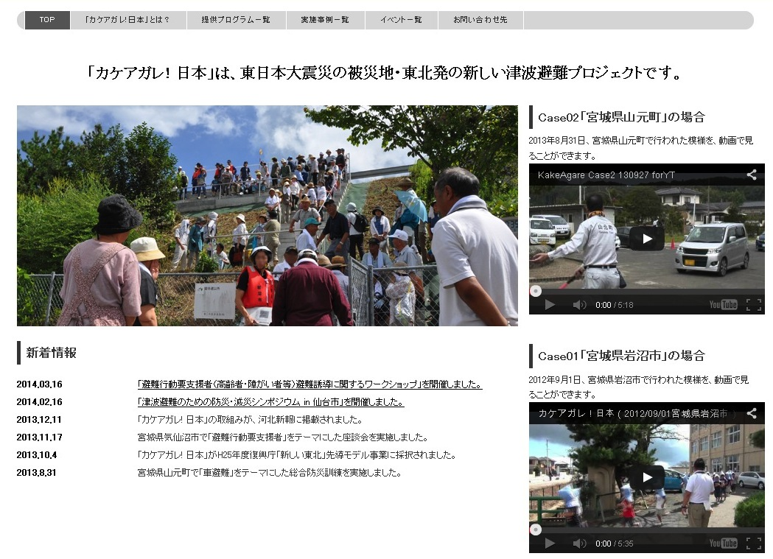
Please contact us!
http://kakeagare.jp

