Slide 1

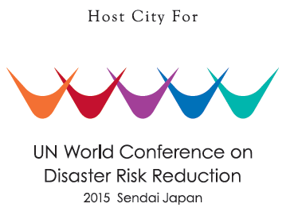


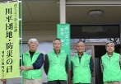


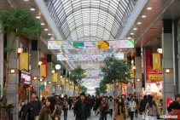
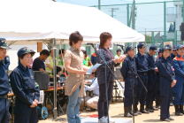

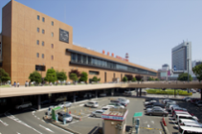
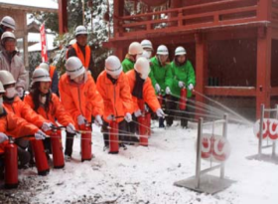
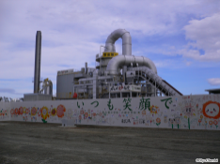
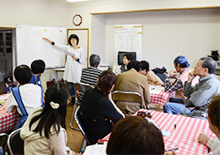

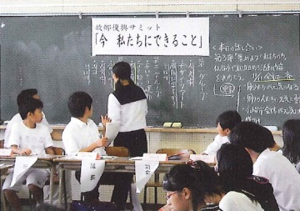
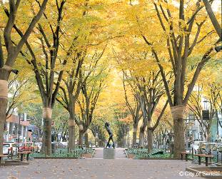

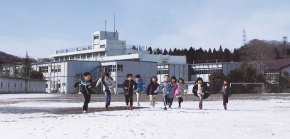
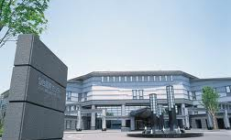
ともに、前へ 仙台
Moving Forward As One SENDAI
The 3rd UN World Conference on Disaster Risk
Reduction
～Message from Sendai, Tohoku
UN World Conference on Disaster Risk Reduction
Local Preparation Office of the 3rd UN World Conference on Disaster Risk Reduction, Sendai City
Kazuyuki Numata (Section Chief of Preparation)

Slide 2
１ The 3rd UN World Conference on Disaster Risk Reduction

Slide 3
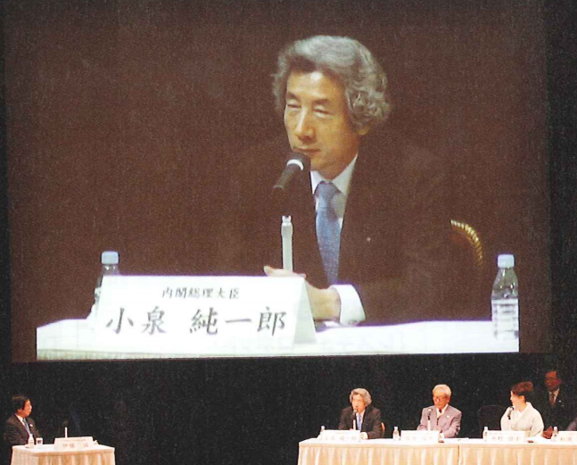
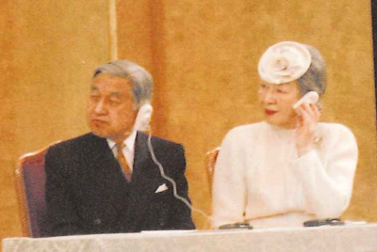

Outline of the Conference
・Organizer: United Nations
・Objectives: To review the progress of the Hyogo Framework for Action (HFA), to further implement the HFA, and to develop the next strategy.
All UN member states, international organizations, and NGOs will participate!
193 countries and regions, over 5000 participants (Main conference)
Video
Message
※2005 Conference in Kobe City
Notes:
3

Slide 4
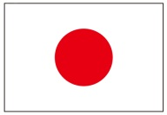
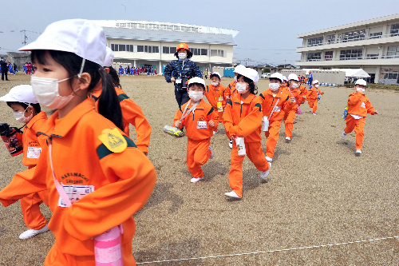
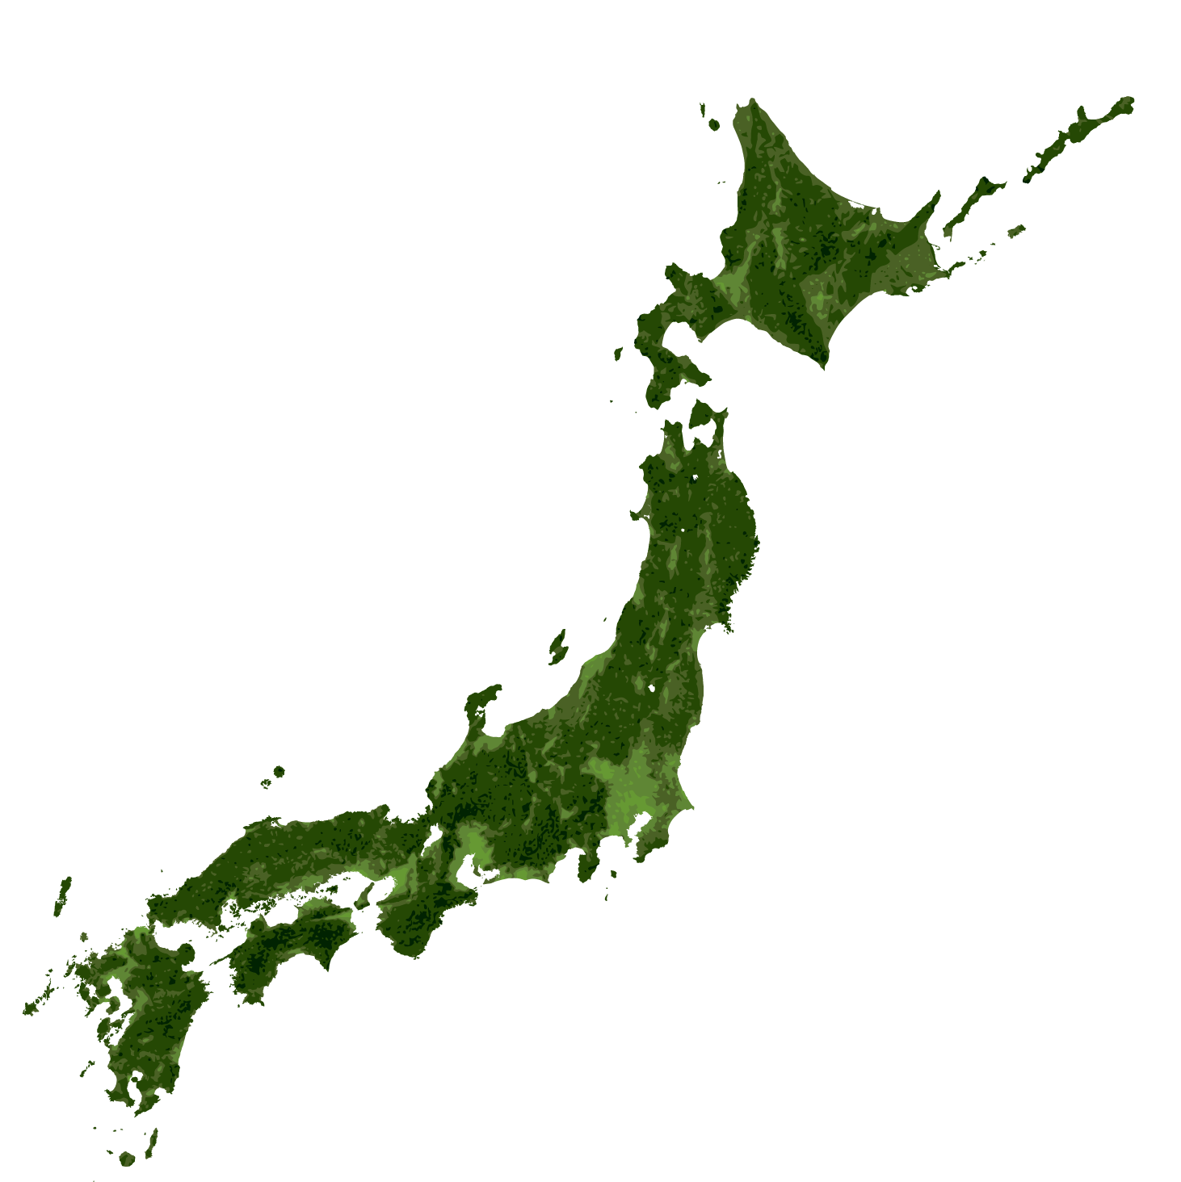
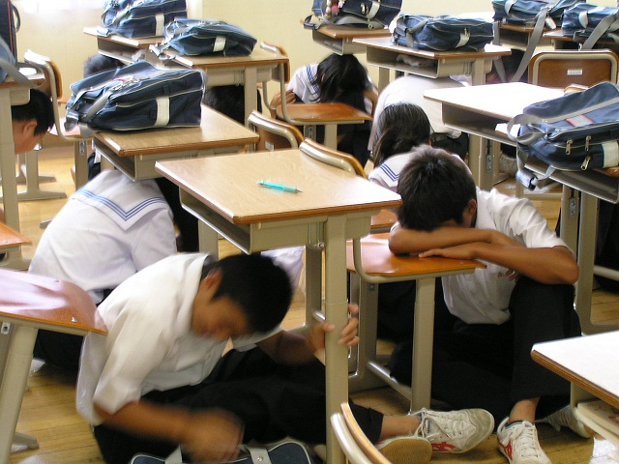

Expectations Towards Japan and Sendai
All 3 conferences held in Japan
1995
Great Hanshin-Awaji Earthquake
2011
2005
Great East Japan
Earthquake
Hyogo
2015
Sendai
・Know-how on disaster risk reduction that we learned and improved from many disaster experiences
・World’s only city with a population of 1million that has experienced M9.0 earthquake
・Action of evacuation decided their fate. What is the lessons-learnt from the experience that can disseminate to the world?
1994
Yokohama
The international community has expectations for the experience and knowledge of Japan and Sendai regarding disasters and DRR.
It is the area we can demonstrate our presence and leadership!
Notes:
4

Slide 5


Schedule
2015
3
3
3
3
3
14
15
16
17
18
SAT
SUN
MON
TUE
WED
Main Conference
★
Opening
Ceremony
Inter-governmental meetings
various meetings
★ Closing
Ceremony
UN
Official visit
Related Events
General Forum
Symposium and Seminar for Citizens
3
Exhibition
19
THU
Welcoming Events
★ Welcoming Reception
★ Excursion
Japanese Cultural Experience
Program for Spouses
Information Center, Hospitality
Welcoming Decorations
Notes:
5

Slide 6
２ Importance of investing continuously in Disaster Risk Reduction

Slide 7
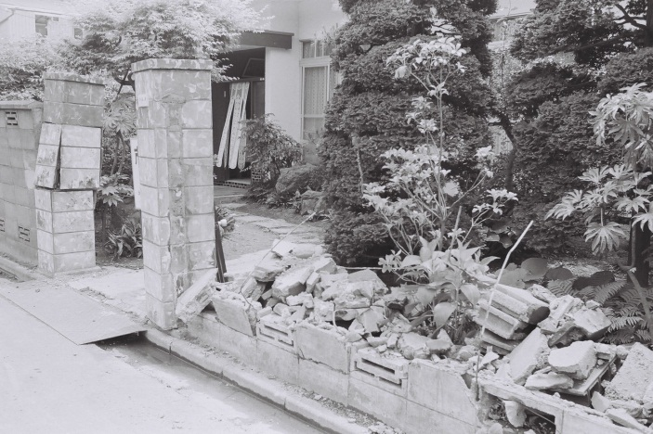
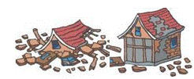
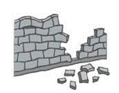
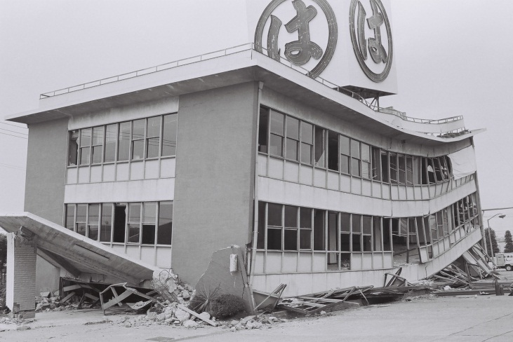
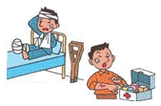
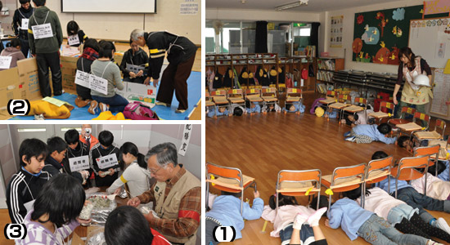
Miyagi-ken-oki Earthquake（1978）
Time
Damage
1981 Major amendment in Building Standard Law regarding earthquake resistance standard
June 12, 1978 5:14pm
Scale
Magnitude 7.4
Destroyed brick walls
Completely destroyed 4,385
Partially destroyed 86,010
Destroyed brick walls etc.
11,740
Deaths 16
Injuries 10,119
Collapsed building
Major
disaster reduction policies in Sendai
（1978～）
・Anti-seismic enforcement of buildings built before amendment of building standard law
・Lifeline with anti-seismic structure and its multiplexing
・Removal of brick walls with high risk of collapsing
・Improve DRR education and drills
・Wider collaboration with other cities
Drill in kindergarten
Notes:
7

Slide 8
Importance of anti-seismic structure
Others
It is highly important for buildings to be earthquake-proof
Being burned
In the Great Hanshin-Awaji Earthquake, 80% of the deaths were caused by building collapse.
About 70% of the buildings constructed under the old standard （before 1981) were heavily damaged!
Cause of Casualties
Before 1981
Old Standard
Heavy Damage
Moderate Damage
No/Slight Damage
Being crushed
Police White Paper, Fiscal 1995
From 1982
New Standard
Heavy/Moderate Damage
No/Slight Damage
Source: Interim report by the survey committee of the building disaster by the Great Hanshin-Awaji Earthquake Building and Disaster, 1995
Under the amendment of the Building Standard Law in 2000, further reinforcement of the earthquake resistant standard of wood-frame buildings was made.
For example, it became necessary to have a basic structure/foundation according to the resistance of land. Regulation on balance of arrangement for earthquake-proof walls was developed.

Slide 9
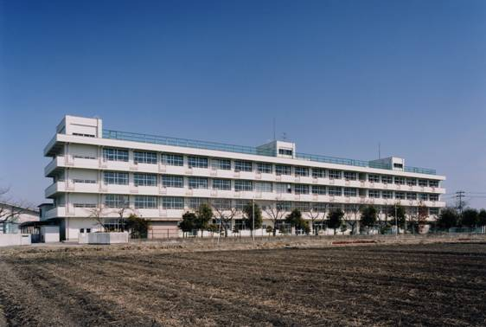
Commitments by Sendai City on earthquake proof retrofit（Under Old Standard）
Private Buildings
Subsidies for earthquake resistance survey:
Wood-framed houses and apartments, condominiums
Subsidies for earthquake-proof retrofit:
Wood-framed houses and apartments
City-owned Buildings
An elementary school that went under additional earthquake-proof work
・City’s elementary, junior and senior high schools, special schools for the handicapped, etc. （1,119 in total） were 100％earthquake-proof before the Great East Japan Earthquake and Tsunami.
・There were no injuries among students due to building collapse by the 2011 disaster.
・As well as to protect children’s lives, earthquake resistant structure for schools is important to enable schools to function as evacuation center.
・Earthquake resistance surveys for non-school buildings owned by the city were also conducted.
・If the building did not meet the new earthquake resistant standard, the city decided either to carry out retrofit work, reconstruct, or shutdown the property.
・There were no cases of termination of administrative functions due to building collapse of city-owned buildings by the 2011 disaster.

Slide 10
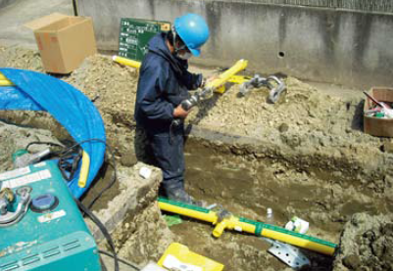
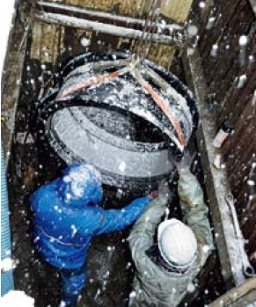
Enforcement of Urban Infrastructure
Enforcement of urban infrastructure beforehand was the key to success.
DRR measures were implemented to some extent, based on the lessons learned from the Miyagi-ken-oki Earthquake (1978).
Gas
・Service to 310,000 households was stopped. Recovered completely 37 days after the disaster
・No damages to polyethylene gas pipes, highly resistant to earthquakes
Polyethylene gas pipes had no damages
Waterworks
・Water supply: service to 23,000 households was stopped. Recovered in 18 days
・Sewerage: No damages to earthquake resistant facilities
(Huge damage by the tsunami)
Brick walls
・Subsidies for removal and switching to hedges
・No casualties due to destroyed brick walls. There are still many remaining, a future issue.
Investment in developing disaster-proof urban infrastructure can be highly effective and valuable.
Water supply recovered in 18 days
Notes:
10

Slide 11
２３３ Importance of preparation for response procedures under emergencies including needs assessment

Slide 12
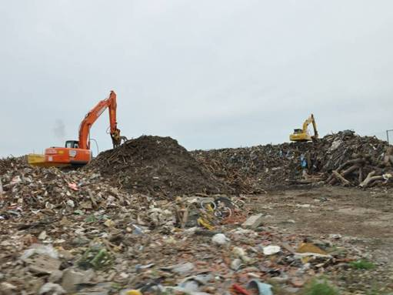
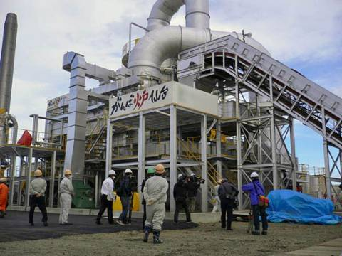
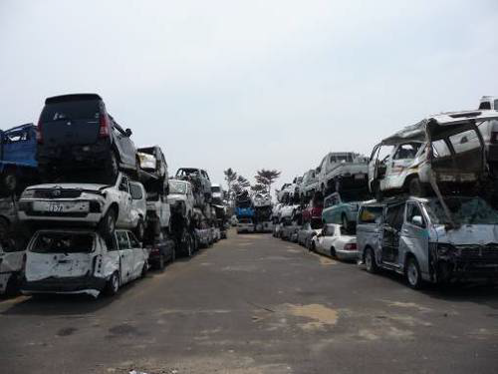
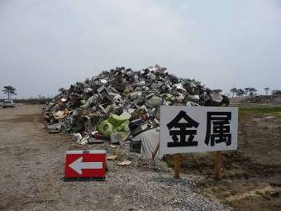
Disposal of Disaster Waste
Dec. 2011 Removal was completed.
Sep. 2013 Incineration was completed.
Mar. 2014 Disposal was completed.
（including restoration of rubble storage site）
Aim : to recycle over 50 % of total rubble
Total disposal volume １,３７ million tons
Volume of rubble in Sendai city
approx.１,３５ million tons
（4 year’s worth of disposal）
As of Mar. 2014 recycling rate ; 72％
Sendai Method（disposal inside the city）
Affected site
burnable
non-burnable roughly
recyclable separated
（temporary incinerator）
（damaged vehicles）
rubble storage site
Three storage sites in the eastern coastal area（total １００ｈａ）and temporary disposal facilities were made.
Rubbles were separated into over 10 types such as concrete, home appliances, wood, etc.
（home electric appliances）
（metal）
12
Notes:
12

Slide 13
Disposal of Disaster Waste（２）
Complete Stop in Waste Disposal
Mar. １１ Human waste disposal facilities were fully destroyed due to tsunami
All waste incineration plants made emergency stops and were damaged due to vibration from the
earthquake
Mar. １２ Collection of human waste from temporary toilets at evacuation centers began
Mar. １３ Garbage collection at evacuation centers began
Mar. １４ Plants resumed operation
Mar. １５ Temporary waste storage sites where citizens bring in disaster waste by themselves opened (5 in the city)
Collection of household garbage and human waste resumed
Mar. ２４ Collection of wet household goods etc. in areas affected by the tsunami began
Mar. ２８ Temporary recovery of human waste disposal site
Mar. ３０ Rubble storage site made available to pubic
Removal of disaster waste in areas affected by the tsunami began
Environmental-friendly Measures
・Asbestos・・・Monitoring at all areas within the city. Scattering asbestos waste from pulling down damaged houses removed and sealed on the spot, taken directly to final disposal site, then buried.
・Soil Contamination・・・Asphalt paving and anti-leak sheet lining at rubble storage sites
・Dioxins・・・Same level of exhaust control facilities as existing waste disposal plants

Slide 14
Disaster Waste Handling System
Feb. 2007 Sendai City developed a disaster waste management plan
To prepare for the next Miyagi-ken-oki earthquake, estimation method for the amount of
disaster waste and the dimensions of temporary storage sites, as well as sorting categories and handling system of disaster waste was developed
March 11, 2011 The Great East Japan Earthquake
Based on damage assessment, discussion on the disaster waste handling system began
Mar. 31, 2011
According to the management plan, the volume of waste was estimated based on the survey of damage
Apr. 1, 2011 Disaster waste handling policy was decided
For prompt handling, it’s necessary to capture the extent of the damage and take necessary actions precisely and quickly
Therefore, it is efficient to prepare the procedure of needs assessment after a disaster beforehand

Slide 15
Cooperation with local companies
Agreement for disaster response prior to March 11
Sendai City
Sendai Construction Industry Association
Supervision・Discussion・Report
Miyagi Demolition Contractors Association
Contract
Miyagi Industrial Waste Association
Construction control
Supervision・Report
Member companies
Business with local companies ⇒ local rehabilitations lead to local economic recovery
Cooperation in normal periods ⇒ quick response in the event of a disaster

