Slide 1
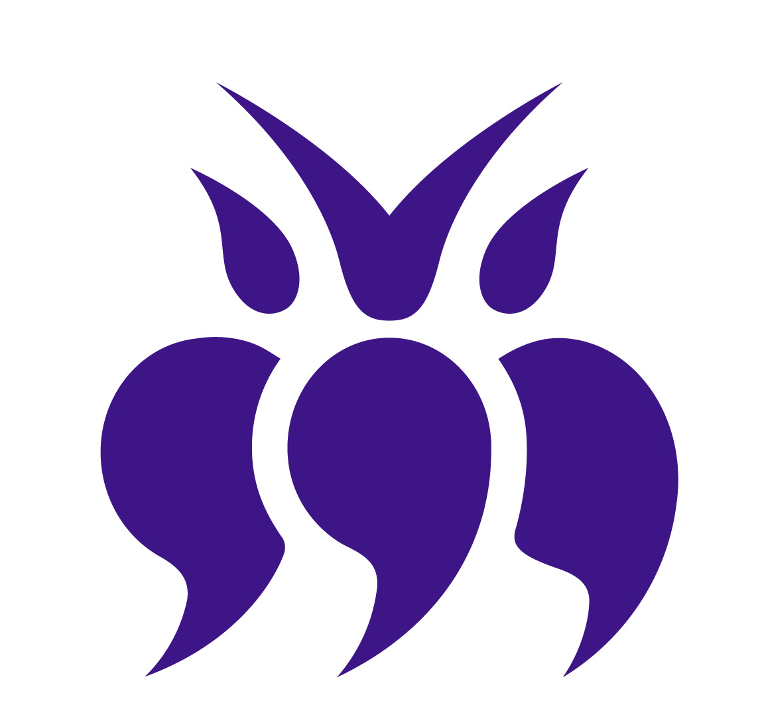

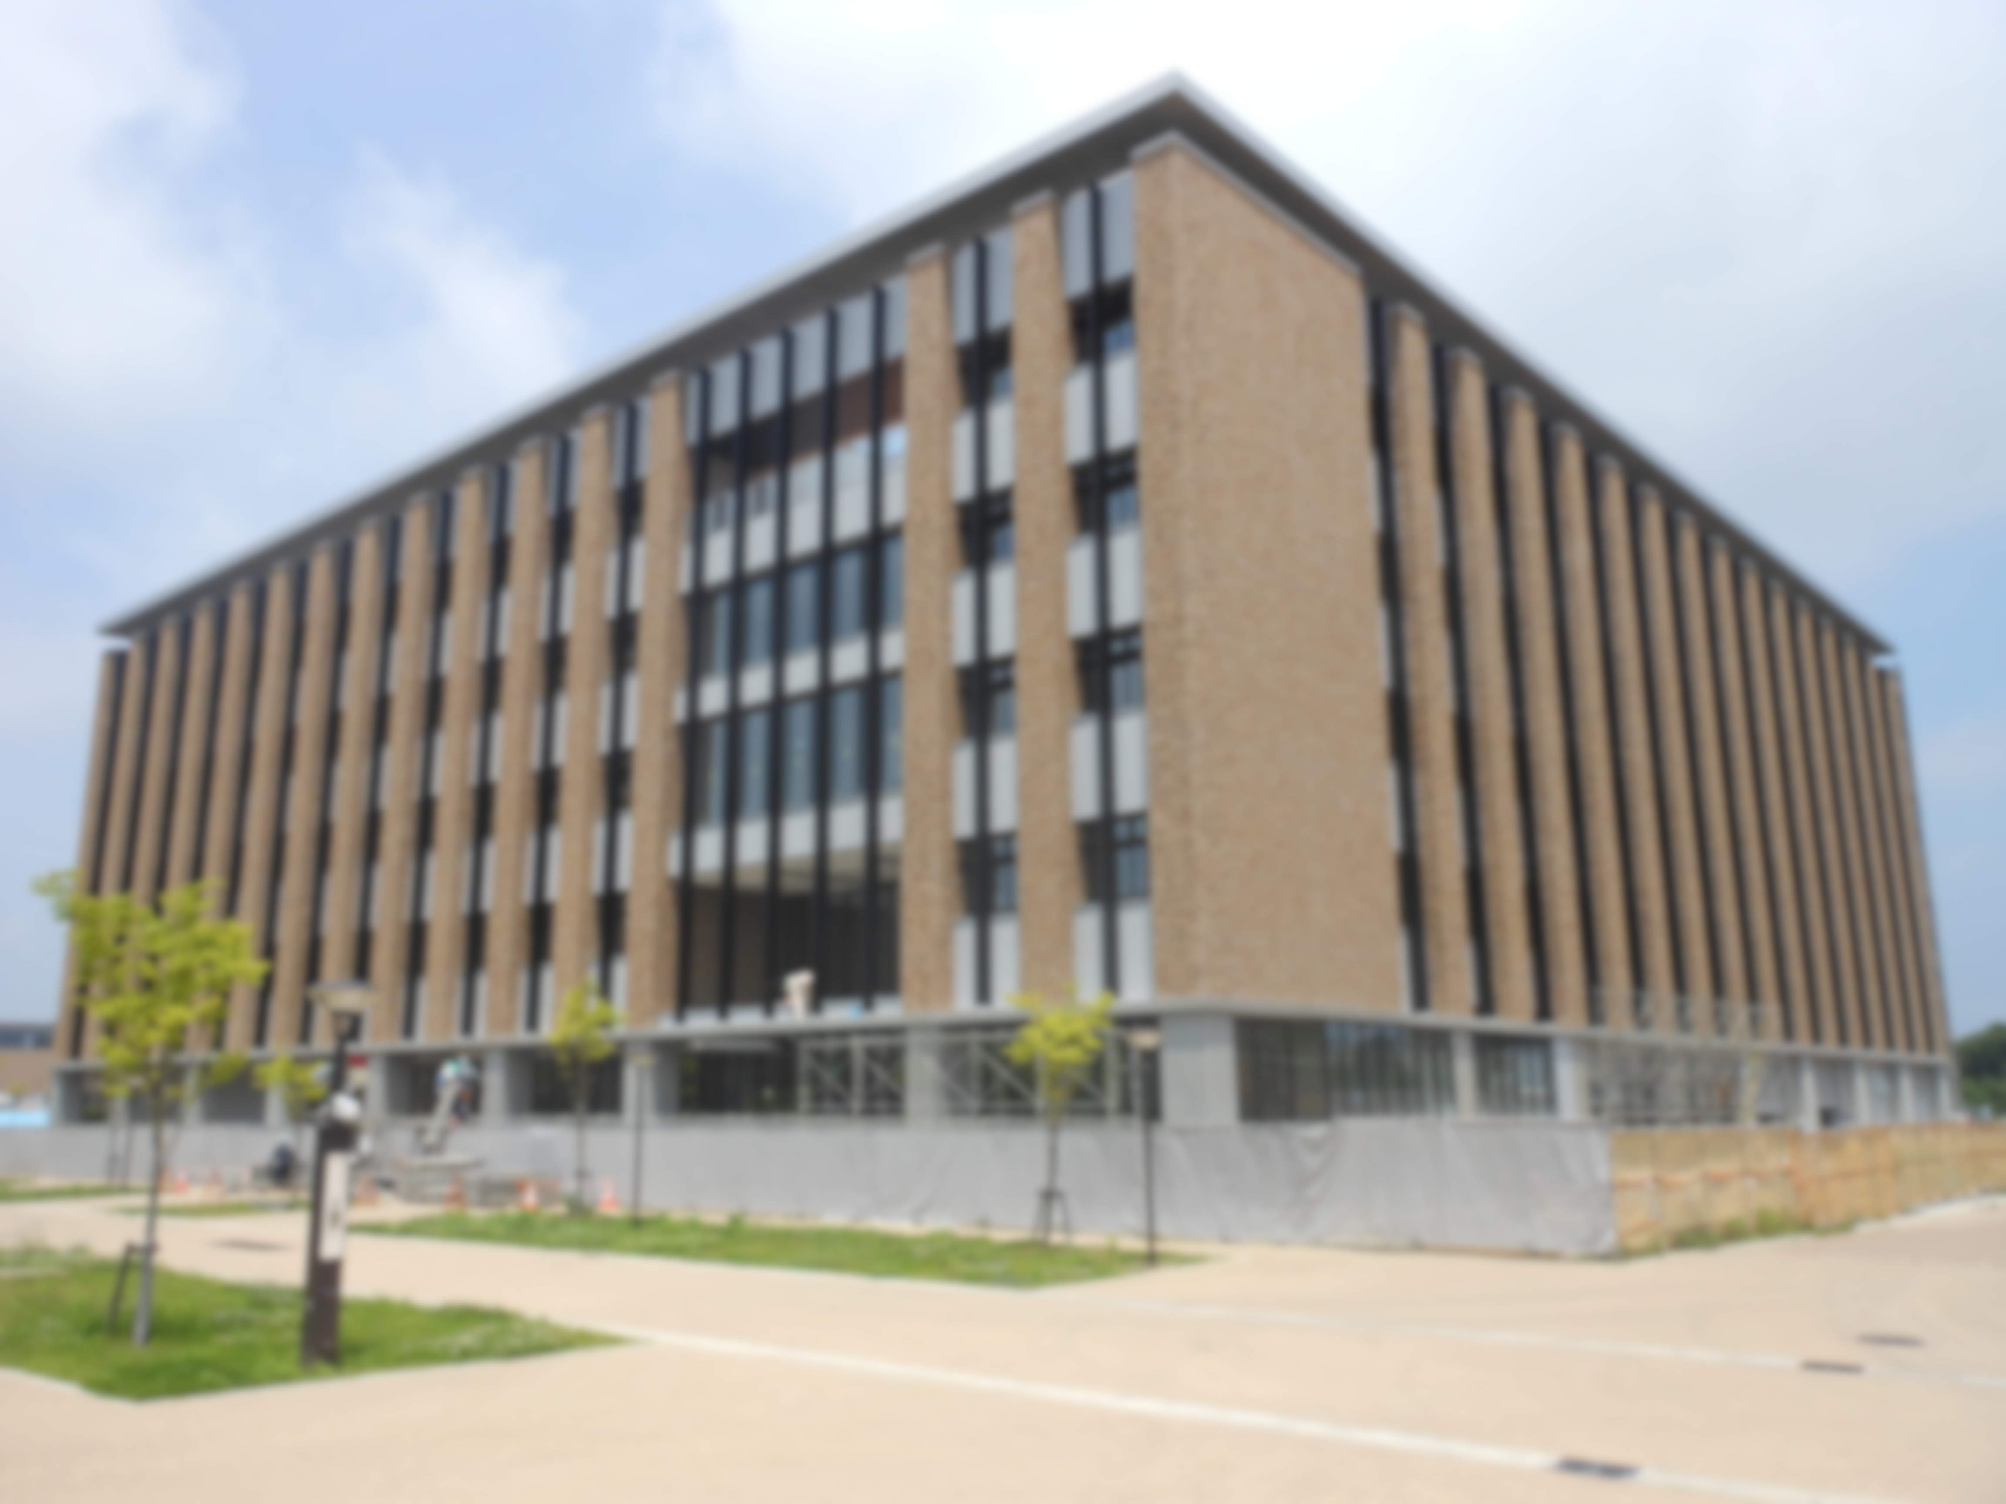
Introduction to
International Research Institute of
Disaster Science (IRIDeS)
Tohoku University
東北大学 災害科学国際研究所
International Research Institute of
Disaster Science(IRIDeS), TOHOKU University

Slide 2
IRIDeS overview:
  IRIDeS: International Research Institute of
  Disaster Science
  Founded in Tohoku University
    Tohoku U. : one of a few universities worldwide to experience a historic mega-disaster
    Established on April 1, 2012
  7 departments, 37 areas of specialization
  Approximately 100 researchers
  Annual budget: JPY 800 million ($10 million); secured for the first 10 years

Slide 3
Key Concepts in Disaster Management
Hazard Strength of natural event
Exposure Inhabitants, industries, facilities
Vulnerability weakness of human-social system
Resilience Speed of bouncing back
Activity Level
Arrival of Hazard and Exposure
Vulnerability
(1／preparedness)
Loss
Resilience
Time
Damage
∝Hazard×Exposure×Vulnerability
(∝Hazard × Exposure ÷ Preparedness）

Slide 4
Adaptation Strategies
We cannot control the Natural Hazards
Decrease the vulnerability (prevention)
  Building Facilities physically stronger
Decrease the exposure (aversion)
  Land-use control
  Temporal pre-disaster evacuation
Increase the resilience (mitigation)
  Back-up, storage, Response
  Insurance, special finance
Combinations

Slide 5
Need of Multi inter-disciplinary Approach
Decrease the vulnerability (prevention)
  Building Facilities physically stronger
Decrease the exposure (aversion)
  Land-use control
  Temporal pre-disaster evacuation
Increase the resilience (mitigation)
  Back-up, storage, Response
  Insurance, special finance
Natural Science,
Engineering
Social Science,
Behavior Science
Urban Planning
Social Science,
Economics
Medical Science
Combinations

Slide 6
  Uniqueness : Multi-interdisciplinary structure
Research area |  |  | Tohoku Univ. IRIDeS | Univ. of Tokyo E Institute | Kyoto Univ. D Institute | Niigata Univ. R Institute | Fukushima Univ. S Institute | D Institute
Hazard and Risk Evaluation Disaster Science |  | Earthquake, Tsunami | Hazard and Risk Natural Disaster Science | 研究所全体 （4部門，4研究センター，3マネジメントセンター） | 地震・火山研究グループ | 環境変動科学部門 複合災害科学部門 地域安全科学部門 |  | 地震・火山 研究ユニット 兵庫県耐震工学研究センター
 |  | Volcanic
 |  | Wind and Rain |  |  | 地盤研究 グループ 大気・水研究 グループ |  |  | 水・土砂防災 研究ユニット
 |  | Snow Storm |  |  |  |  |  | 雪氷防災 研究センター
Human & Social Response |  |  | Human and Social Response |  |  | 地域安全科学部門 | 研究所全体 （11研究会）
Regional & Urban Reconst-ruction | Regional safety |  | Regional and Urban Reconstruction
 | Radiation Decontamination
 | Robotics
Medical Relief |  |  | Disaster Medical Science
Public Cooperation |  |  | Information management |  | 総合防災 研究グループ |  | 研究所全体 （11研究会） | 災害リスク 研究ユニット
International Collaboration |  |  | Yes | Yes | Yes
総合防災
研究グループ
災害リスク
研究ユニット
地域安全科学部門
Multi-interdisciplinary also includes research on different types/areas of hazards, low frequency high risk disasters

Slide 7
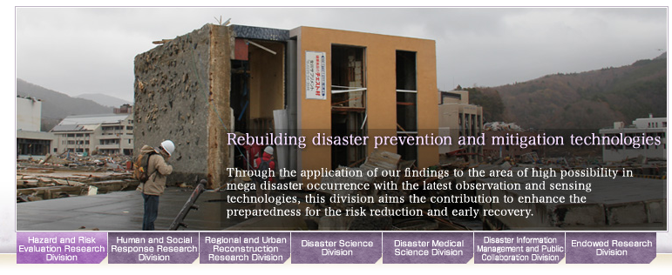
IRIDeS: A new institution in a disaster stricken area
Principle:
  Promote world’s leading research on natural disasters through:
    learning from the GEJE and tsunami;
    contributing to the regional recovery; and
    set an international paradigm on disaster management studies

Slide 8
Mission
  Establish “practical” disaster management studies
    Identify and theorize disaster-related phenomenon in each stage of disaster cycle
    Establish an area of
    disaster management
    study that supports
    building societies
    more resilient to
    disasters
    Internationally-
    driven research/
    educational activities
Disaster
Disaster impacts
Emergency response
Rehabilitation and Reconstruction
Preparedness
(Future disaster mitigation)
Disaster Cycle

Slide 9
Institutional structure
  7 departments, extensive collaboration beyond IRIDeS
Disaster Science
Regional and Urban Reconstruction
Hazard and Risk Evaluation
International Research Institute of Disaster Science (IRIDeS)
Endowed Research Division
Disaster Information Management and Public Collaboration
Human and Social Response
Disaster Medical Science
Research institute in Japan and overseas
Private companies
Affected local governments

Slide 10
Mid- and long-term objectives
  Elucidate mechanisms related to global-scale natural disasters and its impacts
  Restructure disaster prevention and reduction technologies (reflecting on the GEJE case)
  Establish “Disaster Supportology”;
  Reevaluate disaster management and rebuilding utilizing historical knowledge
  Strengthen urban and regional resiliency with multiple redundancies against natural disasters
  Constitute mega-disaster and wide-area responsive medical treatment system
  Design society with better disaster risk management, incorporating knowledge and lessons learnt

Slide 11
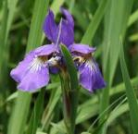
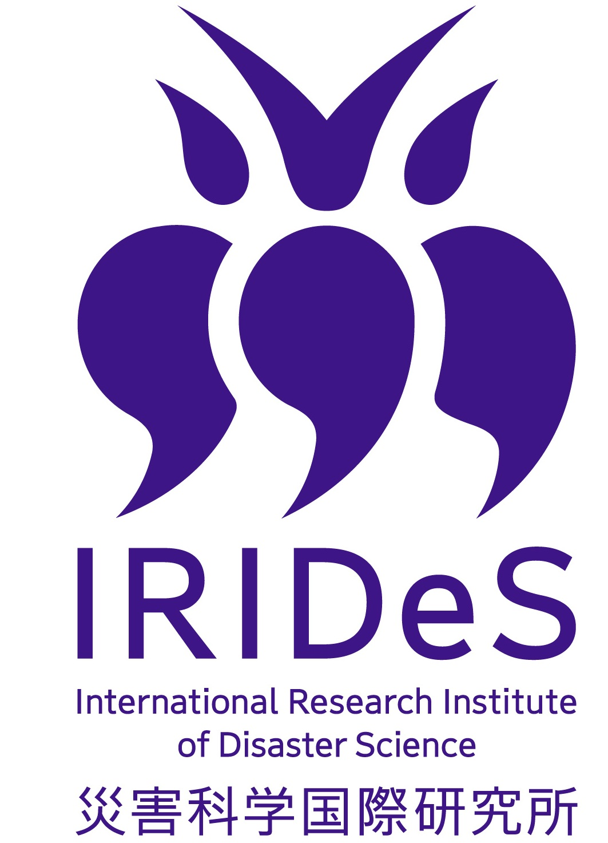
Origin:
  IRIS (plural)
  Violet (Color of Iris)
  (Color of Tohoku Univ.)
    Nobility and desire
  Logo: reversing Chinese
  Character for disaster
  A proverb: “Disaster turns
  into blessings”
災
災
災

Slide 12
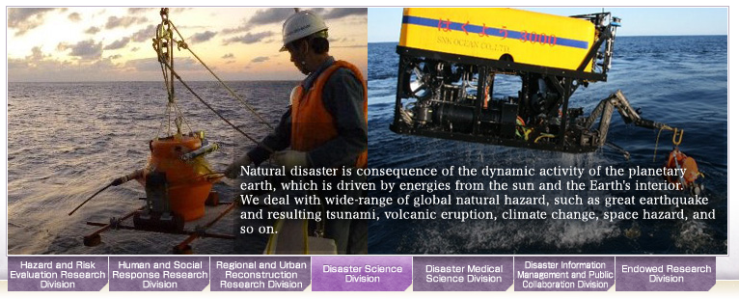
Current Activities
Project-based research activities
  Research with domestic and international universities
    12 projects granted for type A (corporation with leading institutions); US $4million
    70 projects granted for type B (inside IRIDeS and cooperative ); US $2million
    Grants will be provided every fiscal years, up to 10 years

Slide 13
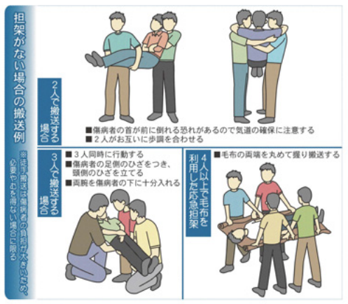
Collaboration with media
  Kahoku Newspaper
    Articles published for Tohoku community to learn. Published once every month, on the 11th day
    Recent topics
      Restructuring to create resilience to/from natural disasters; communication collaboration is critical (October 11)
      Need to prepare for possible
      isolation in an emergency;
      evacuation closer and higher
      (September 11)
      Need to reassess
      recommended emergency
      goods; the importance of
      speaking in an authoritative
      tone in an emergency
      (August 11)

Slide 14
Events and seminars
  Periodical
    IRIDeS Friday Forum:
      Open to public, presentations of the researcher
    GEJE watcher
      Open to public, guests from outside institution
    Public seminars
  Non-Periodical
    Public reporting by Tohoku university
      1 month report, 3 months report, 6 months report, one year anniversary report
    Symposium
      1611 Keicho earthquake 400 year anniversary (Dec. 2011)

Slide 15

Archival project [Michinoku Shinroku Den]
  Collect and archive disaster information
    Data will be collected in Tohoku
    Collecting different events’ data, including historic ones
    All types of data will be archived for future needs
  Establish global standard on archival science
  Will be practical
    System to link with government and industry
    Linking with education
  Create new jobs around this system

Slide 16
Government-academic collaboration
  National governments
    Cabinet office, central disaster management committee
    Ministries:
      Agriculture and fisheries (MAFF)
      Education, Culture, Sports, Science and Technology (MEXT)
      Land, Infrastructure, Transport and Tourism (MLIT)
    Agencies:
      Japan Aerospace Exploration Agency (JAXA)
      Japan International Cooperation Agency (JICA)
      Japan Meteorological Agency (JMA)
  Prefectural governments
  Local governments (Cooperative Agreements)

Slide 17
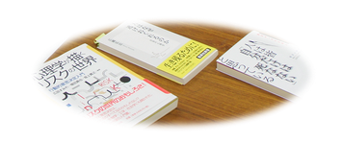
Educational program
  Establishing a disaster management program for higher education
  Aims to educate internationally-prominent researchers in disaster management

Slide 18
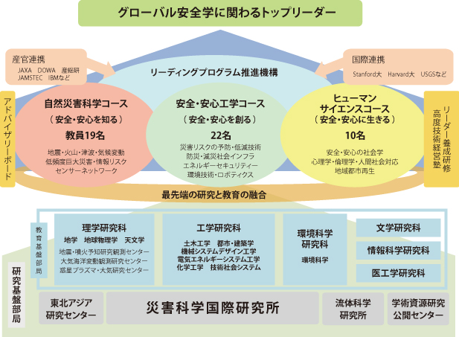
Inter-graduate School Doctoral Degree Program on Science for Global Safety
2012-2018 supported by MEXT
Top Leader for Global Safety
Natural Disaster Science
Course
Safety and Disaster proof Engineering
Course
Human
Science
Course
Linkage betw. Research and Education
Grad. School of
Science
Grad. School of
Engineering
Grad. Sch.
Environ.
Science
G.S. Letters
G.S. Infomatics
G.S. Med. Eng.
C. Of NE Asian Studies
Int. Res. Inst. Desaster Sci.
Inst. Fluid Sci.
Center for Aca.Resource

Slide 19
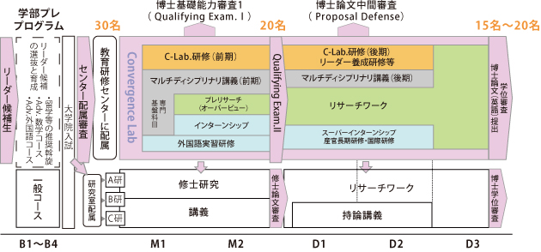
Inter-graduate School Doctoral Degree Program on Science for Global Safety
2012-2018 supported by MEXT
Labo Research
Labo Research
Research work
Multi-disciplinary
Multi-disciplinary
foundation
Pre-research
Research work
Internship
Communication
Internship, overseas
Research
Research
Lectures
Lectures

Slide 20
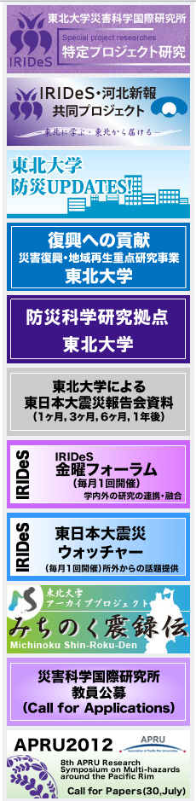
Thank you!
URLs:
http://irides.tohoku.ac.jp/eng/index.html
http://irides.tohoku.ac.jp/index.html

Slide 21
March 11, 2011 disaster and IRIDeS
March 11, 2011 disaster
  Costliest disaster in history from triple tragedy
    JPY 16.9 trillion ($210 billion)
    e.g. $81 billion (JPY 6.5 trillion) for Hurricane Katrina
  Uncovered limitations of modern science and technology
    Large-scale disaster impacts can’t be prevented
    Need longer time horizons for better understanding; importance of referencing ancient documents
  Holistic approach is needed to respond to mega-scale disasters
    Need wider spatial horizons for getting enough cases and experiences : International cooperative research
Notes:
1. Cabinet office estimated direct economic cost at Y16.9 trillion ($210 billion); followed by Kobe earthquake (1995), Hurricane Katrina (2005, 81 billion $US, JPY 6.5 trillion at fixed rate for 2011) second costliest disaster or hurricane Katrina
2. Seismology has developed only after 1900 – and need to explore further

Slide 22
Disaster | Disaster Institute settled in Major National University
1923 Great Kanto Earthquake | The University of Tokyo Earthquake Research Institute（1925-）
1950 Typhoon Jane | Kyoto University Disaster Prevention Research Institute（1951-）
2011 GEJE and Tsunami | Tohoku University International Research Institute of Disaster Science（2012-）
22

Slide 23

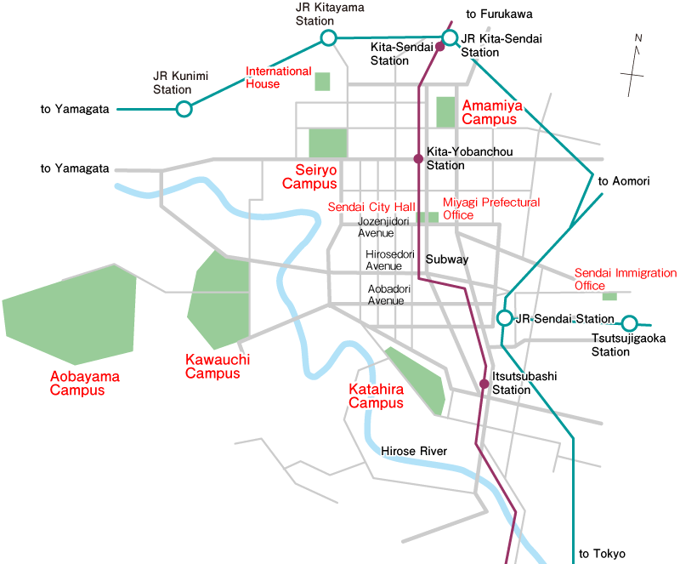
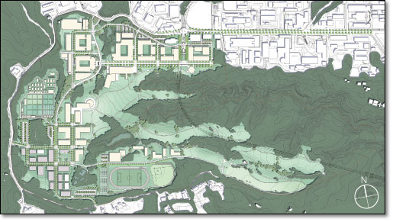
IRIDeS Building, opened this Autumn.
AOBAYAMA
NEW CAMPUS
  Permanent space for the institution has just prepared!
You are here!

Slide 24
